Slide 1
Recommendation of the
IMPROVE/CSN Organic Carbon Artifact Adjustment Committee
Ann M. Dillner, Mark C. Green
Marc Pitchford, Bret Schichtel, Bill Malm, Warren White, Joann Rice, Neil Frank, Judy Chow, Scott Copeland
March 26, 2013

Slide 2
Current OC monitoring by
IMPROVE and CSN
The two networks have reconciled their sampling and analysis methods (CSN transition completed by Jan. 2008):
  Similar samplers (URG)
  Similarly pre-conditioned quartz-fiber filters from the same manufacturer
  Analysis using the same protocol (IMPROVE_A) in the same laboratory (DRI)
The two networks report concentrations according to different conventions:
  Adsorption of organic gases by quartz filters yields artifact ‘particulate matter’.
  IMPROVE adjusts sample filter loadings with an estimate of the artifact, based on back-up filters collected at selected sites.
  CSN reports sample filter loadings directly along with blank values and makes no adjustment.

Slide 3
Recommendation
Use monthly median field blank values to adjust measured OC data in both networks.
Each network uses own field blanks to calculate monthly median field blank values.
Perform adjustment on each thermal fraction (OC1, OC2, OC3, OC4, OP) and sum to calculate OC. (Note: adjusting thermal fractions and summing is the current IMPROVE method).
.

Slide 4
Carbon Sampling Artifacts
Positive artifact: organics in gas-phase adsorb onto filter
Negative artifact: particles volatilize off filter due to temperature and gas concentration changes
Back-up filter (bottom right) may capture both artifacts
Field blanks capture only positive artifact – have no flow and stay in sampler for duration of sampling
Air flow
Notes:
High face velocity affects the artifacts

Slide 5
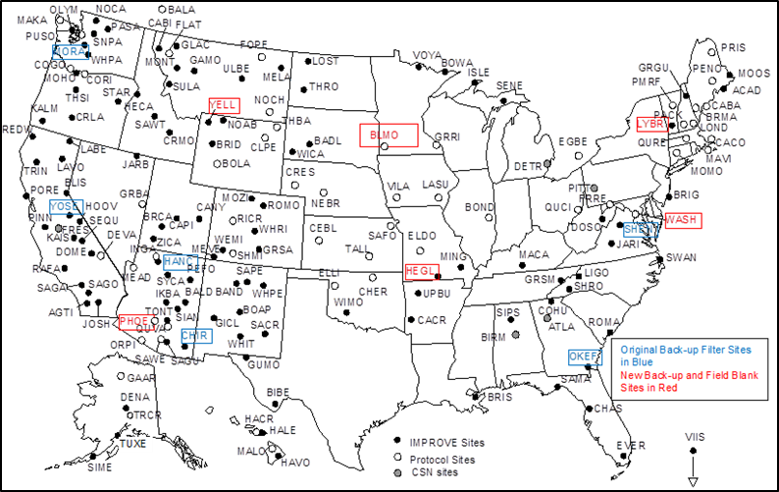
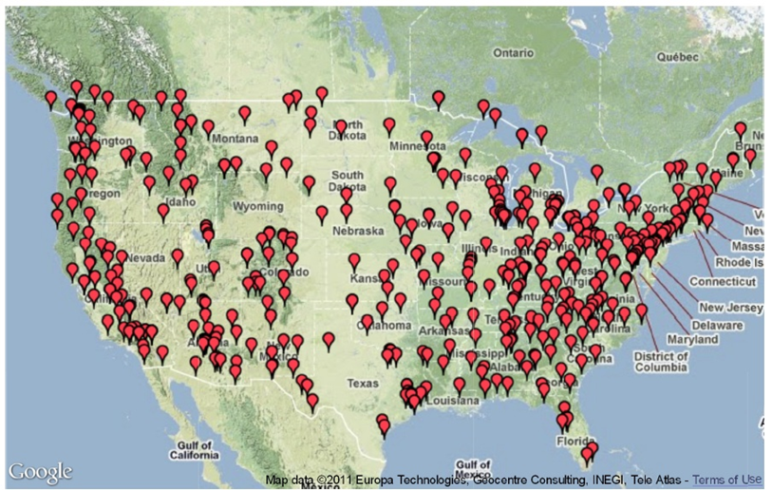
Back-up and Field Blank Sites through end of 2012
CSN - backups & blanks per month
2008 ~60, 2009 ~120,
2010 ~160
IMPROVE – since 8/08
88±33 backups/month,
38±11 field blanks/month
More detailed information on field blanks and back-ups filters for IMPROVE is in the appendix slide 30.
~2% blanks, ~7% backup filters
20% backups and blanks in 2009-2010,
10% since 2011

Slide 6
Two approaches for Artifact Adjustment
Current IMPROVE method –
  Subtract monthly median (MM) back-up OC thermal fractions and total OC mass (determined from 13 sites) from each filter collected in the network for that month
Current CSN method –
  Field blanks and backup filters collected at all sites (~180 sites) but no correction performed
Alternative method –
  Subtract MM field blank OC thermal fractions and total OC mass (all sites) from each filter collected in the network for that month
Each network would calculate its own adjustment factors each month using the same approach

Slide 7
Evaluate current IMPROVE method vs. alternate method for artifact adjustment, to determine which is better able to meet the following criteria:
  Consistent with limited scientific understanding of organic artifacts
  Preserve the measured variation in the data
  Minimize contribution of the artifact to the reported OC particulate matter mass
  Simple to implement (e.g. uses available information and could be applied to historic data) at a reasonable cost and effort
  Applicable to both IMPROVE and CSN for improved data comparability

Slide 8
Approach
Ideally, compare to artifact-free OC measurements – does not exist
Approach used with measurements we have
  Evaluate methods in light of limited understanding of artifacts
  Evaluate variability of monthly median back-up and field blank concentrations
  Decrease artifact in the measured OC
    Evaluate using regression analysis of OC and mass
    Note: Given uncertainties discussed in following slides, y-intercept of regression is an imperfect proxy for artifact

Slide 9
First, a caveat about IMPROVE field blank data before preceding with the analysis

Slide 10
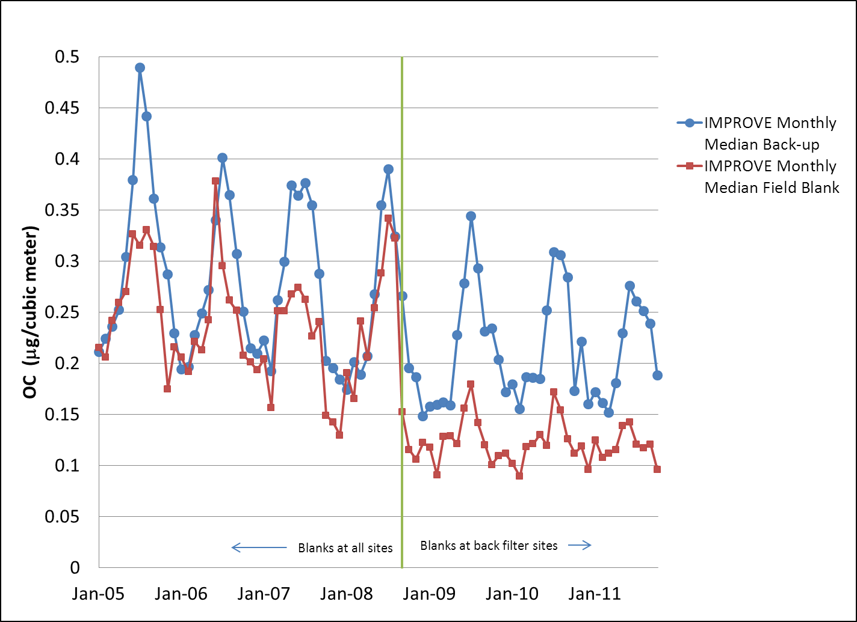
IMPROVE Monthly Median Back-up and Field Blank Concentrations
Field blank OC concentrations decreased when filters began to be collected only at back-up filter sites (8/08). Double quartz field blanks were collected beginning 8/08. Prior to that time single field blanks were collected.

Slide 11
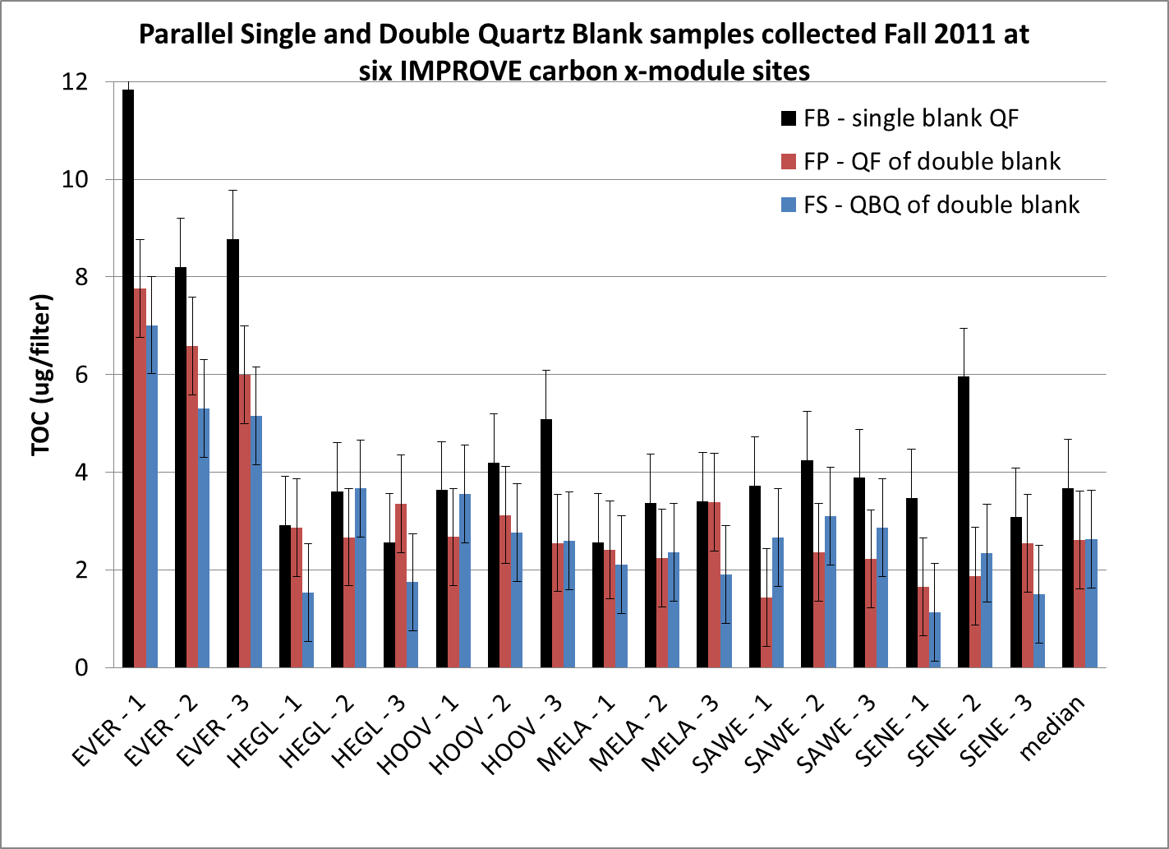
Double Field Blanks
Single field blanks have more OC than either the front or back double field blank filters
  Median of 41% in fall (shown)
  Median of 44% in summer (not shown)
  Large variability in % differences
Field blank data herein is adjusted by 42%.
Although small seasonal difference observed, the observation is based on limited, highly variable data so a single value is used to adjust the field blanks.

Slide 12
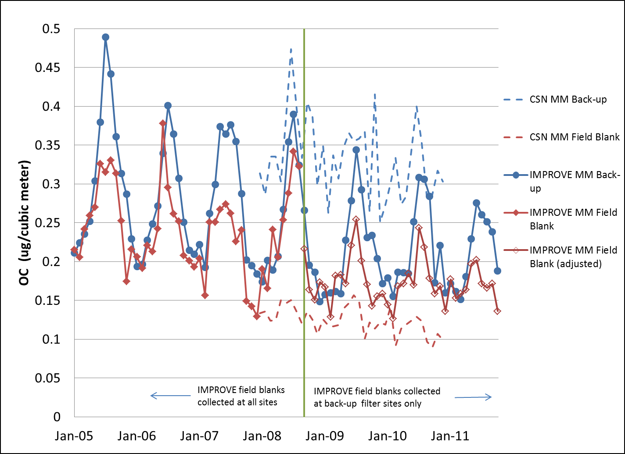
Monthly Median Back-up and Field Blank OC values for IMPROVE and CSN

Slide 13
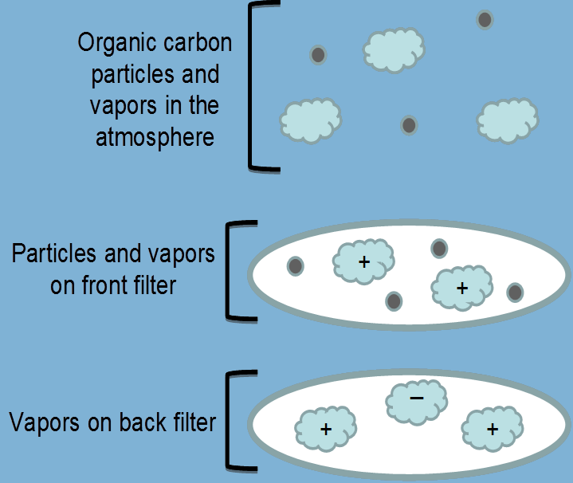

  1. Evaluate methods in light of limited understanding of artifacts
Goal of adjustment is to correct for positive (+) artifact
Back: + and –artifact
Back: may over-correct for +artifact
Field: +artifact
Field: represent artifact that we are trying to remove, may be lower bound on +artifact
Field blanks are a better estimate of + artifact and therefore a better choice
Air flow

Slide 14
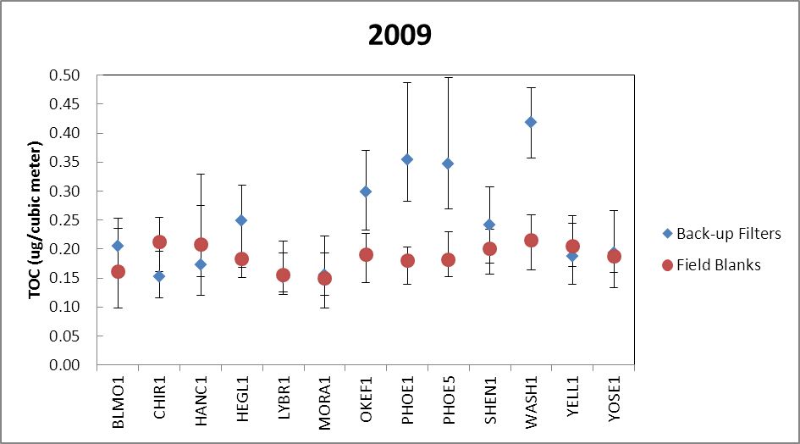
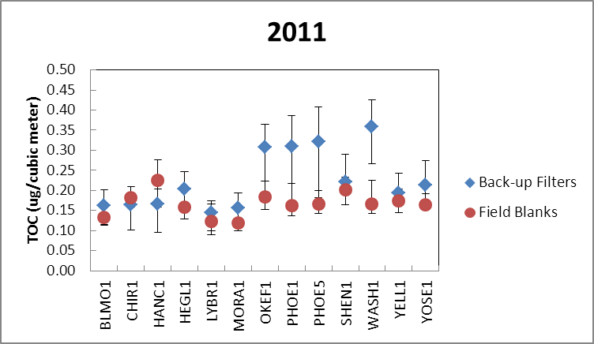
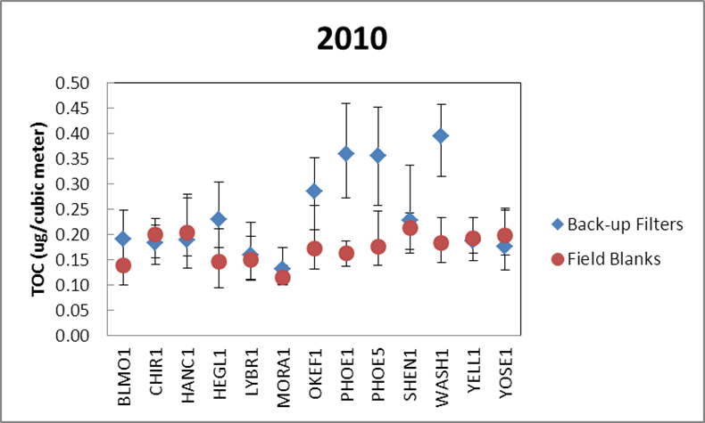
2. Evaluate variability of monthly median back-up and field blank concentrations
IMPROVE Site Medians (with 25th and 75th percentiles) for 2009-2011
Field blanks have less site to site variability and less variability within a site for IMPROVE
Urban sites have higher back-ups than most rural sites, OKEF1 high

Slide 15
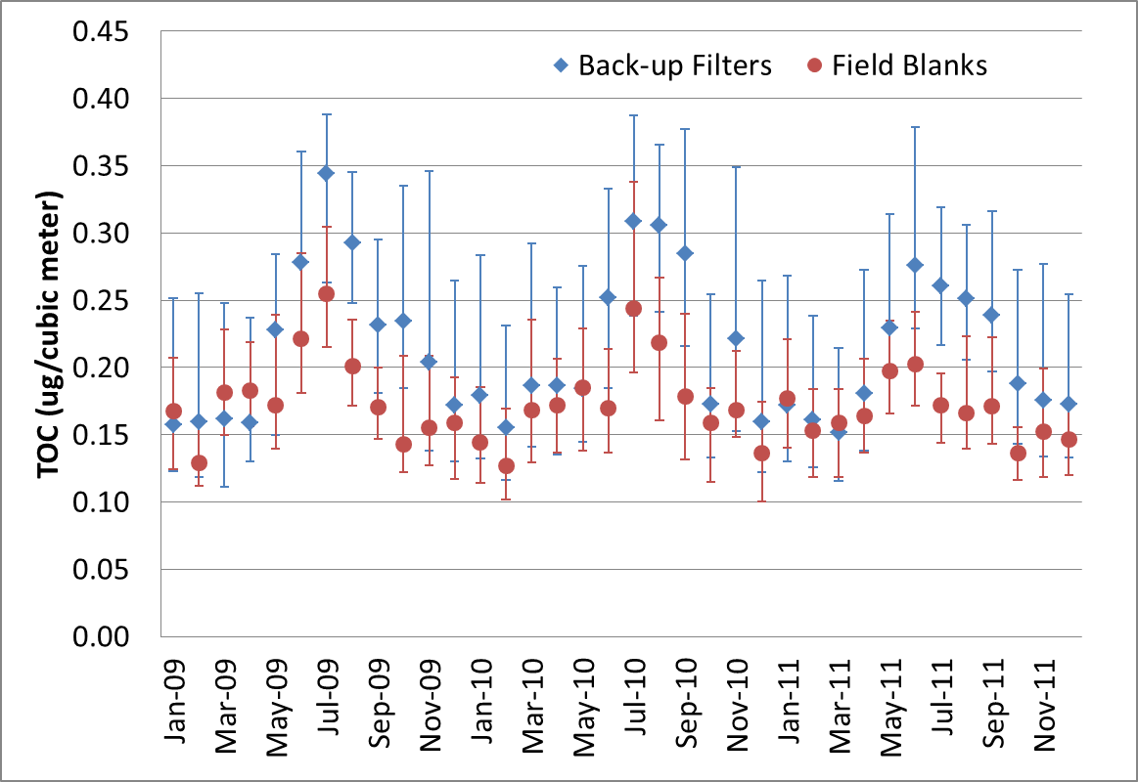
2. Variability: Monthly Median Back-up and Field Blanks in IMPROVE
25th and 75th percentile shown as error bars
Field blanks are usually lower, have less seasonality and less variability within a month than back-up filters for IMPROVE

Slide 16
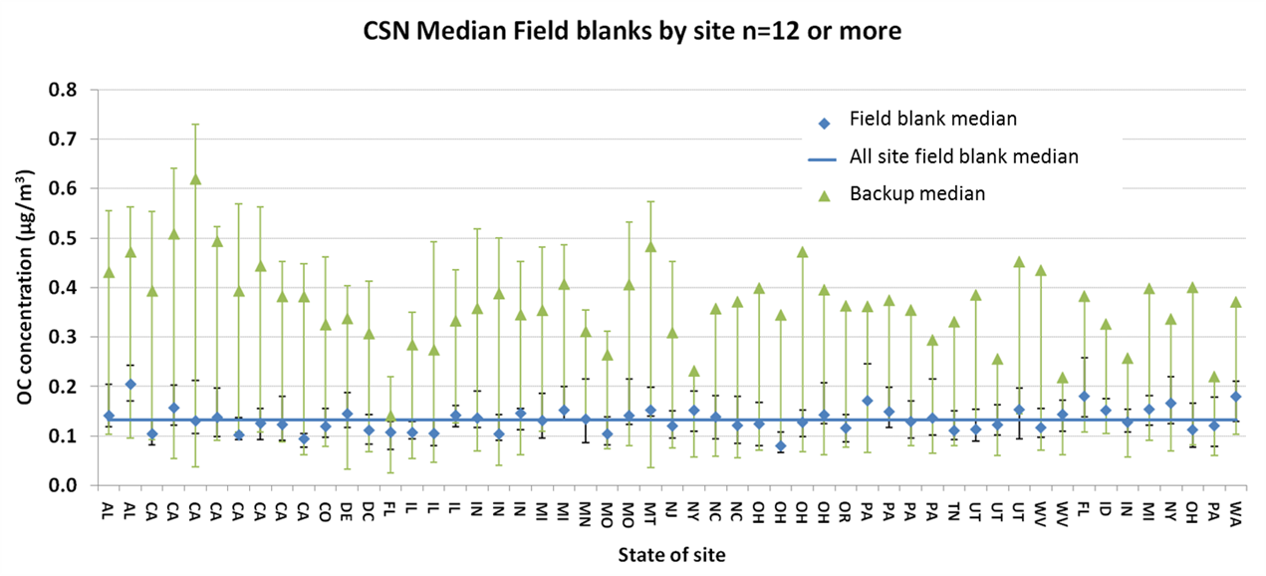
2. Variability: CSN site medians
Field blanks have less site to site variability and less variability within a site for CSN.
Same behavior as IMPROVE data, although the backup filter concentration is slightly higher for CSN (urban) than IMPROVE (rural) and the difference in OC concentration for two filters types is more pronounced.

Slide 17
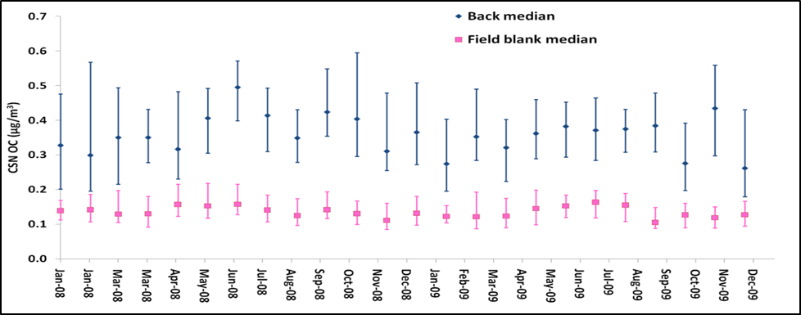
2. Variability: Monthly Median Back-up and Field Blanks in CSN
Field blanks are lower, have less seasonality and less variability within a month than back-up filters for CSN
Same behavior as IMPROVE although the backup filter concentration is slightly higher than IMPROVE and the difference in OC values for two filter types is more pronounced.

Slide 18
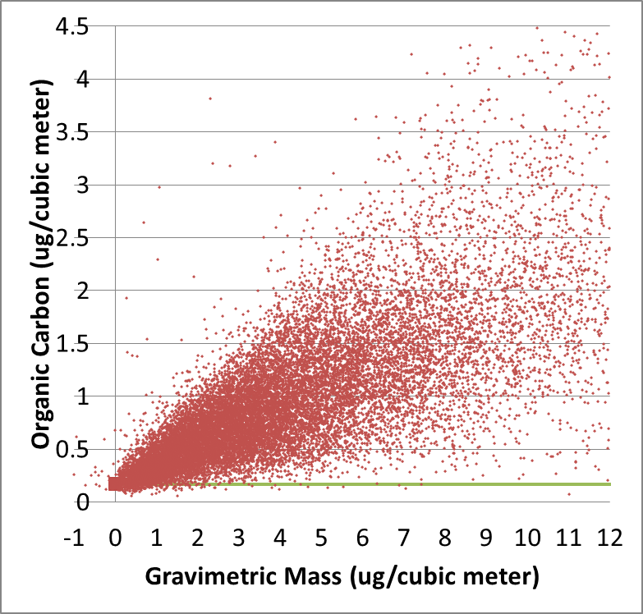
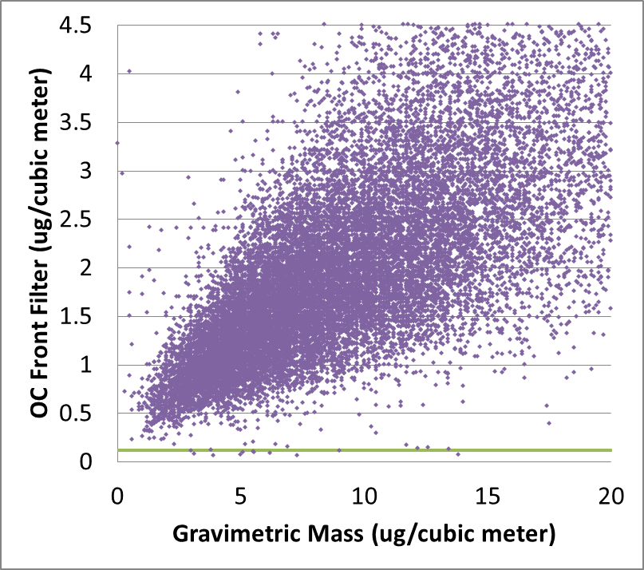
  3. Minimize contribution of the artifact to the reported OC particulate matter mass
IMPROVE – 2009 data
CSN – 2009 data
OC mass does not go to zero as gravimetric mass goes to zero for both networks suggesting a positive OC artifact.
The green line is the annual median of the field blanks. For IMPROVE the value is 0.17 μg/m³ and for CSN the value is 0.12 μg/m³ in 2009.
Notes:
Note: Turpin and colleagues in Maimone et al., AWMA 61, 2011, argue that using regression is not a good method for determining the OC artifact due to possible volitalization of OC and nitrate off the teflon filter, assumes OC artifact is a constant over all sites/seasons/mass range, OC is not necessarily proportional to mass (assumes constant % OC). In our work, we are not using regression to determine the artifact but to compare different OC artifact correction methods in a qualitative way.

Slide 19
3. Intercept of regression (mass v. OC) as an estimate of extent of artifact reduction
IMPROVE | 2009 | 2010 | 2011
Uncorrected OC Intercept (μg/m³) | 0.17 | 0.26 | 0.10
MM back-up corrected intercept (μg/m³) | -0.03 | 0.02 | -0.09
MM field blank corrected intercept (μg/m³) | 0.001* | 0.07 | -0.06
*All intercepts are statistically significantly different than zero, except for MM blank adjusted in 2009
Field blanks and back-ups decrease artifact
Negative intercepts in 2009 and 2011 for MM back-up corrected data suggest that the artifact reduction using back-ups is too large
Limitation of analysis: Reported intercepts are extrapolated values that are sensitive to measurement noise. Therefore, this analysis should not be the sole or primary criterion for choosing a correction method.
Notes:
Uncertainty in mass is included in calculation of intercept (White and Macias, On measurement error and the empirical relationship of atmospheric extinction to aerosol composition in the non-urban West, in Transactions Visibility Protection, Research and Policy Aspects, ACPA, 1986). A variance in the mass error of 0.36 ug/m3 is used to estimate mass uncertainty. This value is the middle of the range of uncertainties observed in 2009-2011 collocated data in IMPROVE. This mass uncertainty does not account for volatile loss of OC or nitrate off of teflon filters.

Slide 20
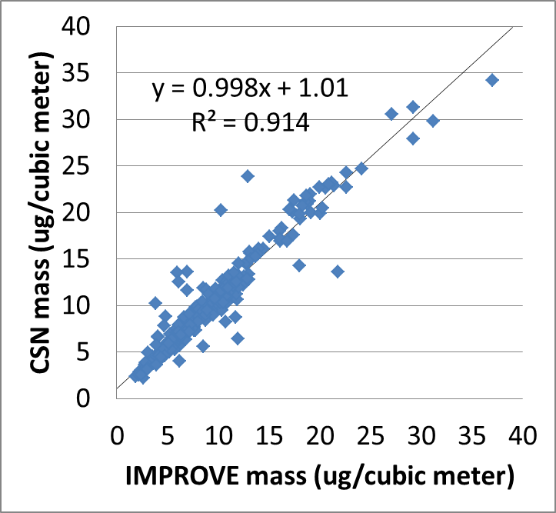
3. Additional limitations to regression analysis for CSN
CSN Teflon filter sampler has lower face velocity than IMPROVE samplers (and CSN OC samplers)
  Mass well correlated for collocated sampling
  Off-set is consistent with fewer semi-volatiles lost
  Gravimetric mass over estimates mass on OC filters
Limited mass data below 1 μg/m³ (slide 18)
Birmingham, Seattle and Fresno

Slide 21
3. Intercept of regression (mass v. OC) as an estimate of extent of artifact reduction
CSN | 2008 | 2009 | 2010
Uncorrected OC Intercept (μg/m³) | 0.61 | 0.60 | 0.44
MM back-up corrected intercept (μg/m³) | 0.25 | 0.27 | 0.13
MM field blank corrected intercept (μg/m³) | 0.48 | 0.47 | 0.33
All intercepts are statistically significantly different than zero
Field blanks and back-ups decrease the artifact
Limitation of analysis:
  Gravimetric mass on Teflon does not represent mass on OC filters
  Necessity of large extrapolation to zero mass (y-intercept) due to little data below 1 μg/cm³
Due to limitations, the comparison of intercepts should not be the sole or primary criterion for choosing an artifact correction for CSN.
Notes:
Uncertainty in mass is included in calculation of intercept (White and Macias, On measurement error and the empirical relationship of atmospheric extinction to aerosol composition in the non-urban West, in Transactions Visibility Protection, Research and Policy Aspects, ACPA, 1986). A variance in the mass error of 0.36 ug/m3 is used to estimate mass uncertainty. This value is the same value as used for IMPROVE filters. This is likely a lower estimate of the variance in mass error for CSN. Larger estimates of the variance of the mass for CSN produce slightly lower intercepts but they are not close to zero and remain qualitatively the same. This mass uncertainty does not account for volatile loss of OC or nitrate off of teflon filters.

Slide 22
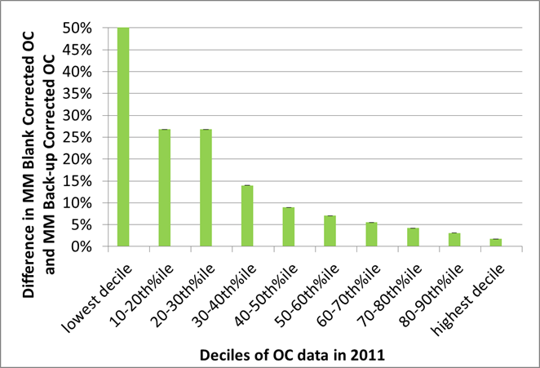
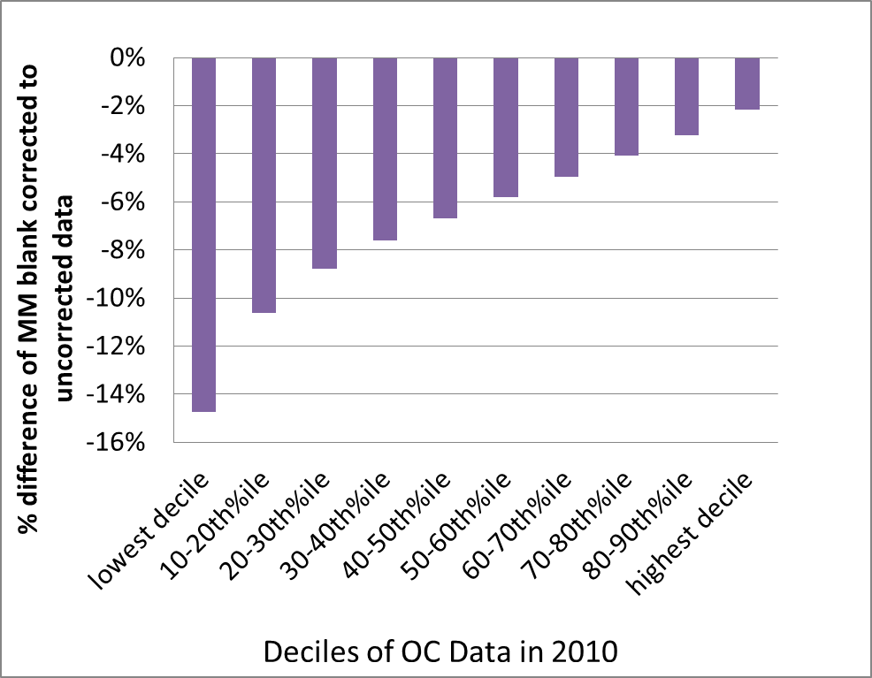
How much will the reported data change?
IMPROVE – difference between MM field blank and MM backup corrected OC
CSN – difference between MM field blank corrected OC and uncorrected OC
OC data will be higher by >10% for
  ~35% of data 2009
  ~50% of data 2010
  ~50% of data 2011
OC data will be lower by >10% for
  ~20% of data 2008
  ~30% of data 2009
  ~20% of data 2010

Slide 23
Summary of Results Relevant to Evaluation Criteria (slide 7)
Field Blanks only collect positive artifact (back-ups may also collect negative artifact), field blanks are a better estimate of the positive artifact on the filter
Field Blanks are less variable over time and space than back-ups for both networks and therefore better preserve (or have less impact on) the measured OC variability than back-up filters

Slide 24
Summary of Results Relevant to Evaluation Criteria (slide 7), cont.
Field blanks decrease the contribution of sampling artifact to reported OC mass.
Field blanks are collected by both networks and can be applied to historical data
This correction method should improve comparability of OC between networks

Slide 25
Recommendation
Use monthly median field blank values to adjust measured OC data in both networks.
Each network uses own field blanks to calculate monthly median field blank values.
Perform adjustment on each thermal fractions (OC1, OC2, OC3, OC4, OP) and sum to calculate OC. (Note: adjusting thermal fractions and summing is the current IMPROVE method).

Slide 26
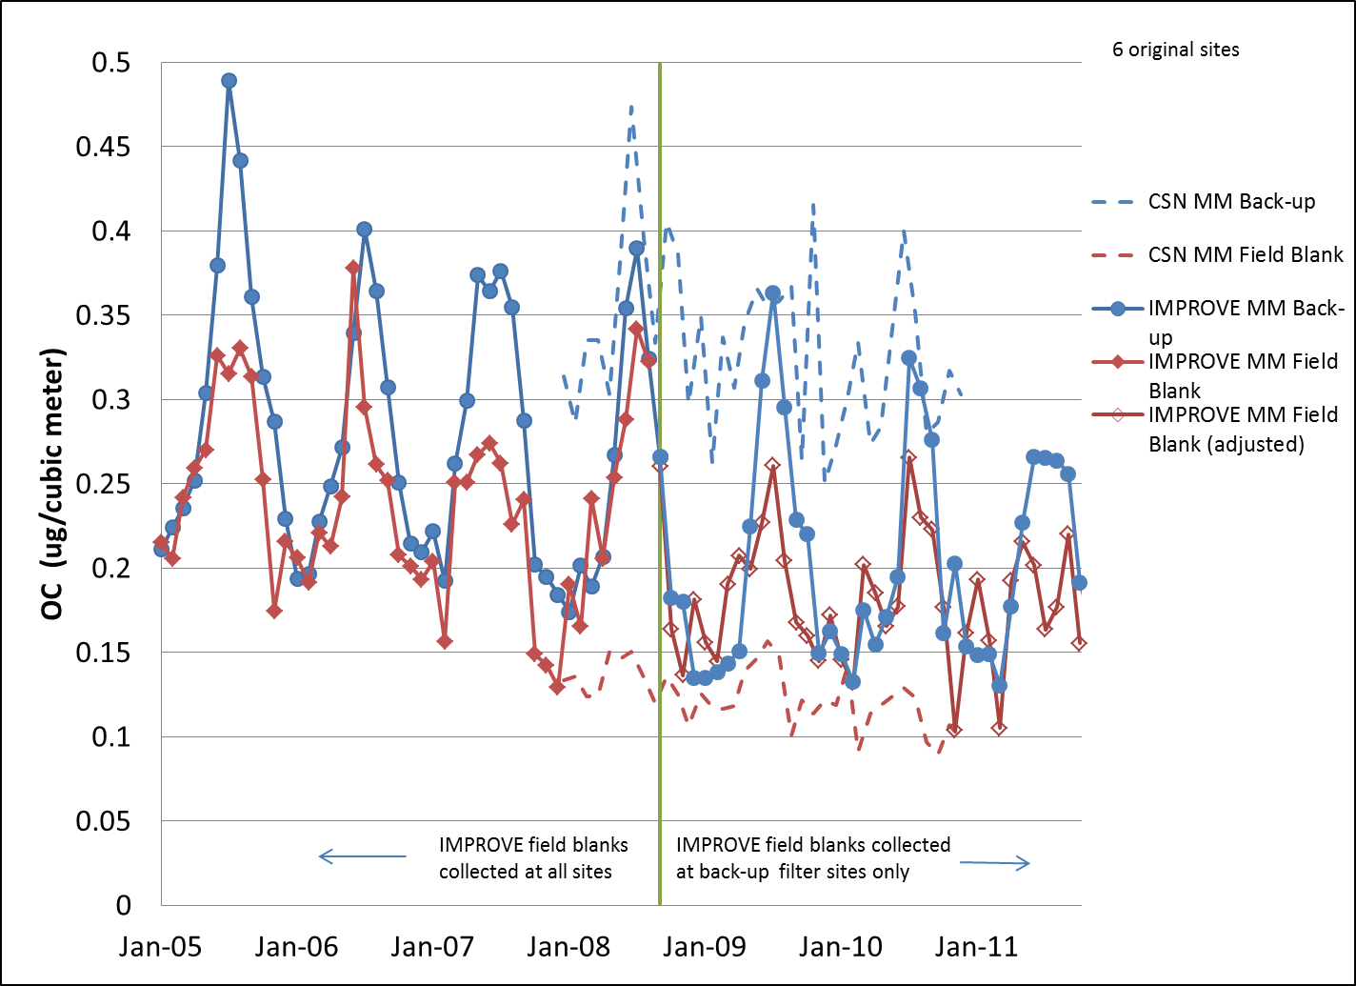
IMPROVE Back-up/Field Blank Sites decreased to original six sites as of 1/2013 due to budget restrictions
13 Back-up/Field Blank Sites
6 Original Back-up/Field Blank Sites
Change in sites does not significantly change medians, especially field blanks. Variability and linear regression results are qualitatively the same and the recommendations do not change.

Slide 27
Current CSN changes due to budget limitations
Field blanks will continue at 10%
Back-up filters will be decreased to 5%
Both back-ups and field blanks will continue to be collected at all sites
Back-ups will continue to be collected on days that correspond with field blanks
This will have no impact on future data quality if the recommended field blanks are used for the artifact adjustment.

Slide 28
Suggestions to IMPROVE/CSN staff for implementing the recommendation
Both networks - Start reporting data using MM field blanks adjustment as soon as is feasible
Change existing data to use MM field blanks
  IMPROVE - January, 2005 when new TOR instrument was implemented
  CSN – when conversion to IMPROVE-like samplers was performed at each site starting in May 2007
Both networks - Report artifact adjustment values in database. This would allow users to use corrected or uncorrected carbon fraction data.

Slide 29
Suggestions, continued
IMPROVE
  Continue to collect and analyze back-up filters at six original sites for IMPROVE to provide data set to evaluate back-up vs field blanks using single blank filters (if funding available)
CSN
  Continue to collect and analyze back-up filters at 5% frequency for comparison to IMPROVE and future evaluation of back-ups vs. field blanks (if funding available)

Slide 30
Appendix

Slide 31
Additional Data on IMPROVE back-ups and field blanks
Sites | 2005 | 2006 | 2007 | 2008* | 2009 | 2010 | 2011
Number of sites in network as of 1/1 | 167 | 165 | 168 | 169 | 169 | 170 | 165
Number of field blank sites | 167 | 165 | 168 |  | 13 | 13 | 13
Number of back-up sites | 6 | 6 | 6 |  | 13 | 13 | 13
*Beginning in August 2008, field blank collection was moved to back-up sites. No data is reported in 2008 for number of back up and field blank sites since it changed mid-year.

Slide 32
Additional Data on IMPROVE back-ups and field blanks
Filters analyzed | 2005 | 2006 | 2007 | 2008 | 2009 | 2010 | 2011
Number of field blanks analyzed | 490 | 461 | 471 | 469 | 492 | 417 | 396
Number of back-up filters analyzed | 699 | 700 | 704 | 900 | 1416 | 1574 | 1441
Percentage of field blank filters in network | 2.4 | 2.3 | 2.3 | 2.3 | 2.4 | 2.0 | 2.0
Percentage of back-ups in network | 3.4 | 3.5 | 3.4 | 4.4 | 6.9 | 7.6 | 7.2
NOTE: Field blanks are collected for one week periods in IMPROVE. Back-ups are collected at the same rate as samples, 1 in 3 days so there are more back-ups than field blanks . Since 8/08 only 2/3 of collected field blanks are analyzed. This table reports analyzed filters. Unanalyzed filters are archived.

Slide 33
Additional Data on IMPROVE back-ups and field blanks
In 2005-2007, approximately 3 field blanks were analyzed per site per year.
2009-2011, approximately 35 field blanks were analyzed at each of the 13 sites per year
The percentage of field blanks remained fairly constant from 2005-2011.
The percentage of back-up filters roughly double in 2008.

Slide 34
Changes to IMPROVE back-ups and field blanks in 2013
Based on Scott Copeland’s 2/25/13 email regarding budget cuts to IMPROVE,
  Field blanks and back-ups will be collected at original 6 sites only
  Decrease in sample weeks per year and sites
Changes in analyzed filters based on cuts
  Field blanks will decrease from 2% to 1% of the network
  Back-up filters will decrease from 7% to 2.5% of network samples.

