Slide 1
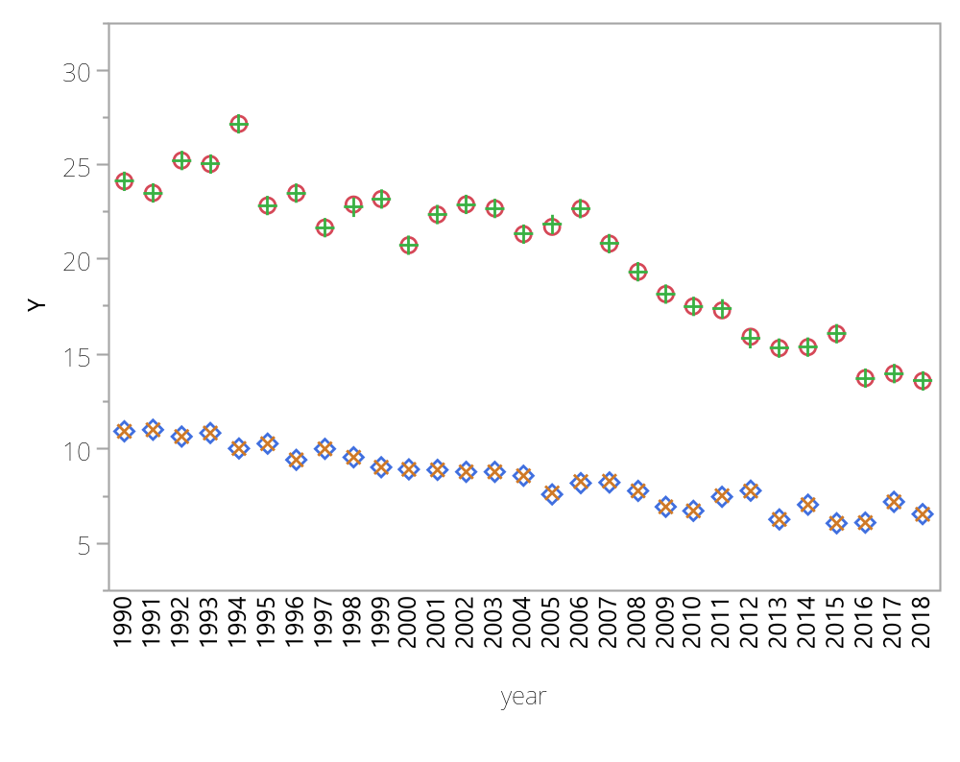

Chart site=ACAD1

Slide 2
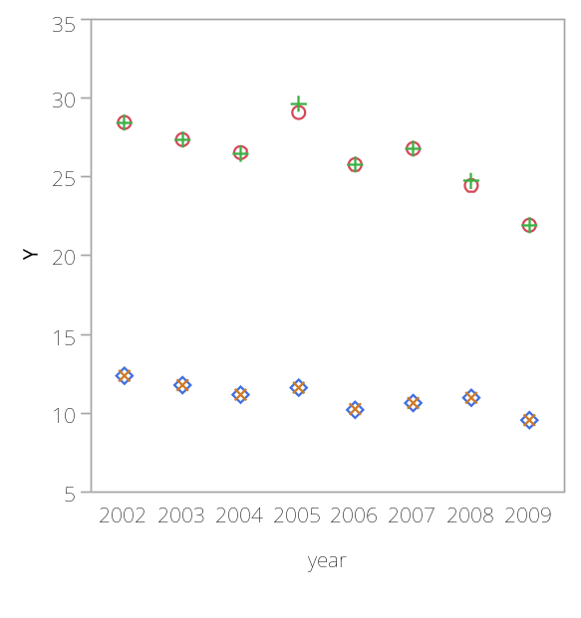
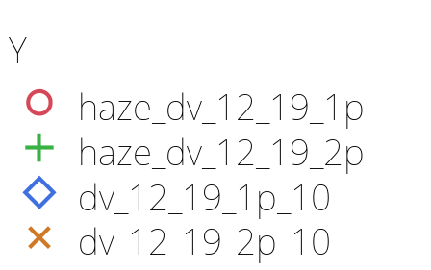
Chart site=ADPI1

Slide 3
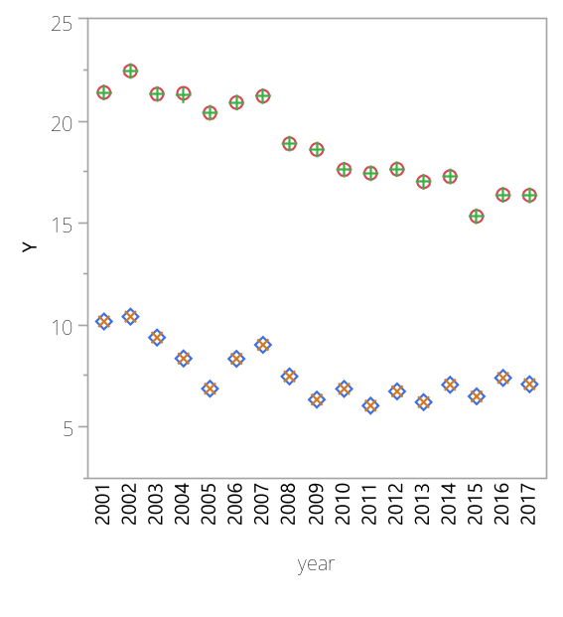
Chart site=AGTI1

Slide 4
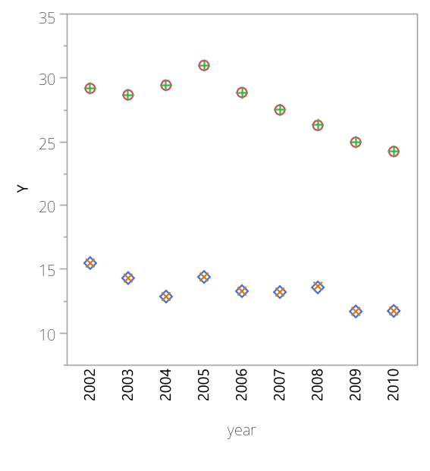
Chart site=AREN1

Slide 5
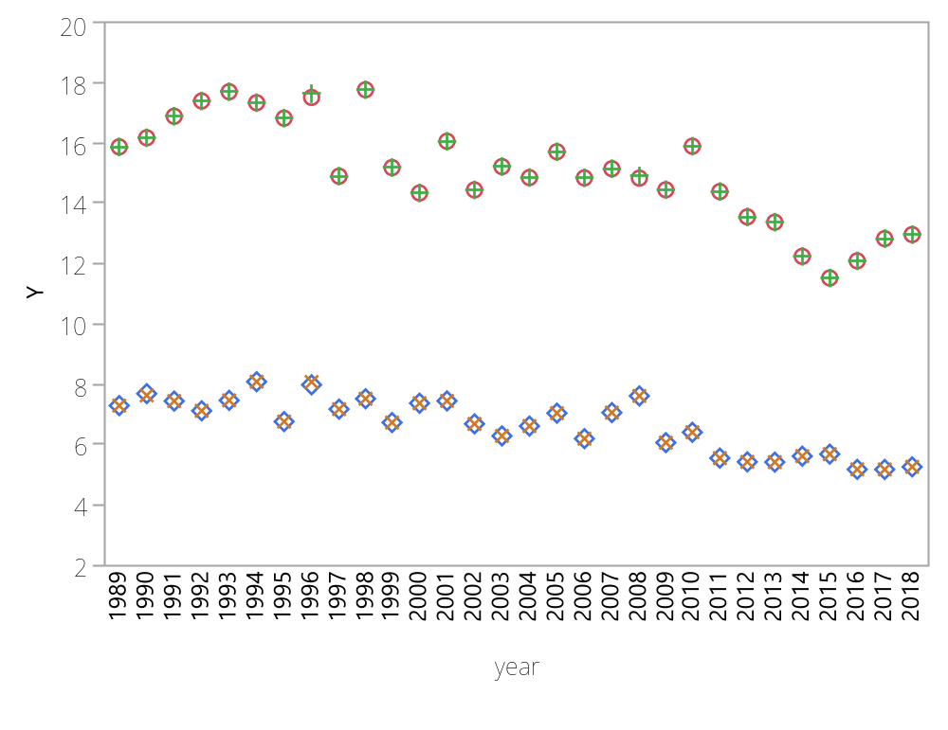
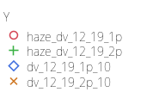
Chart site=BADL1

Slide 6
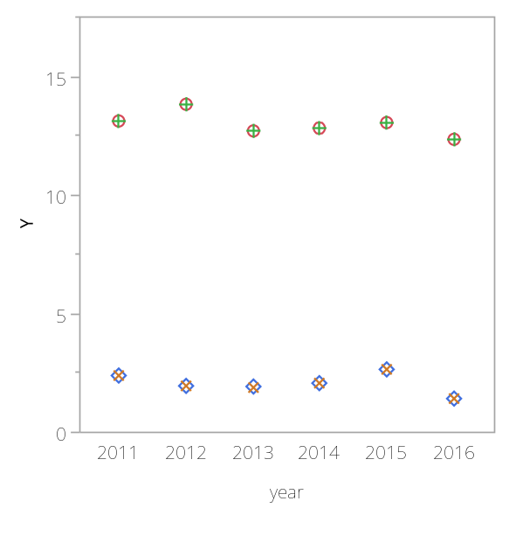
Chart site=BALA1

Slide 7
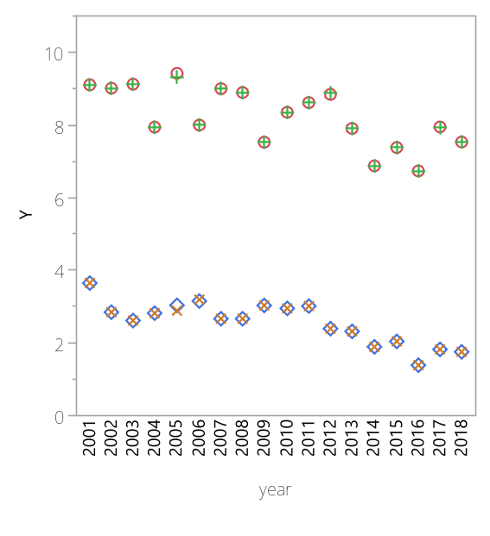
Chart site=BALD1

Slide 8
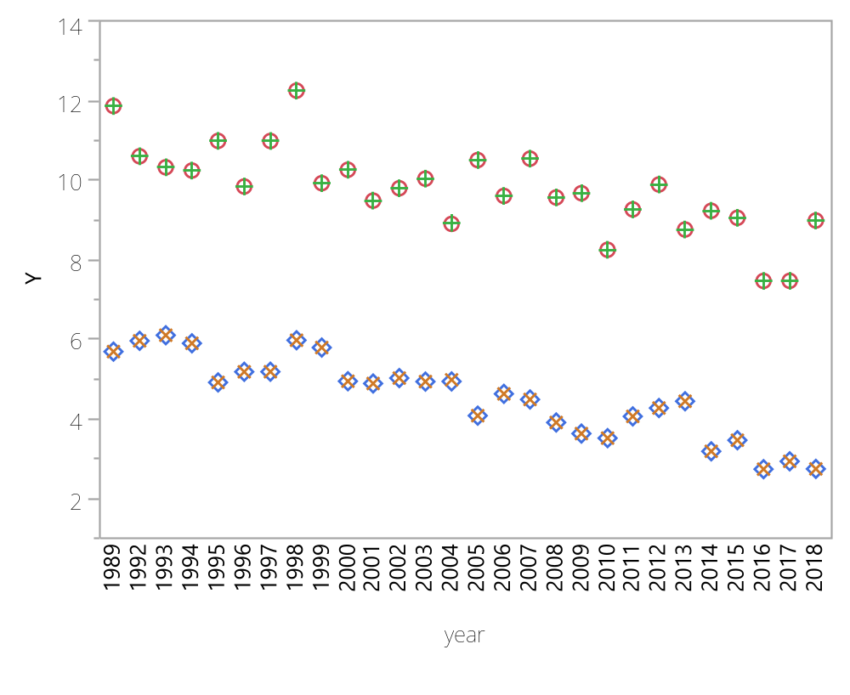
Chart site=BAND1

Slide 9
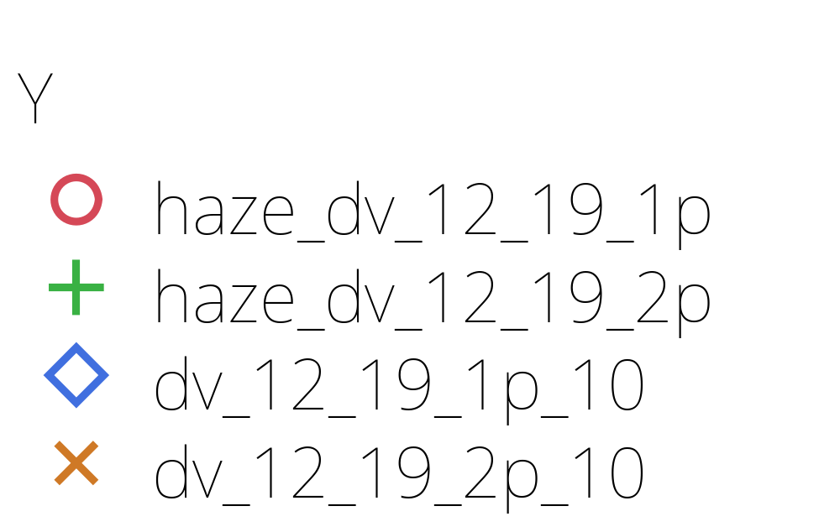
Chart site=BAND1

Slide 10
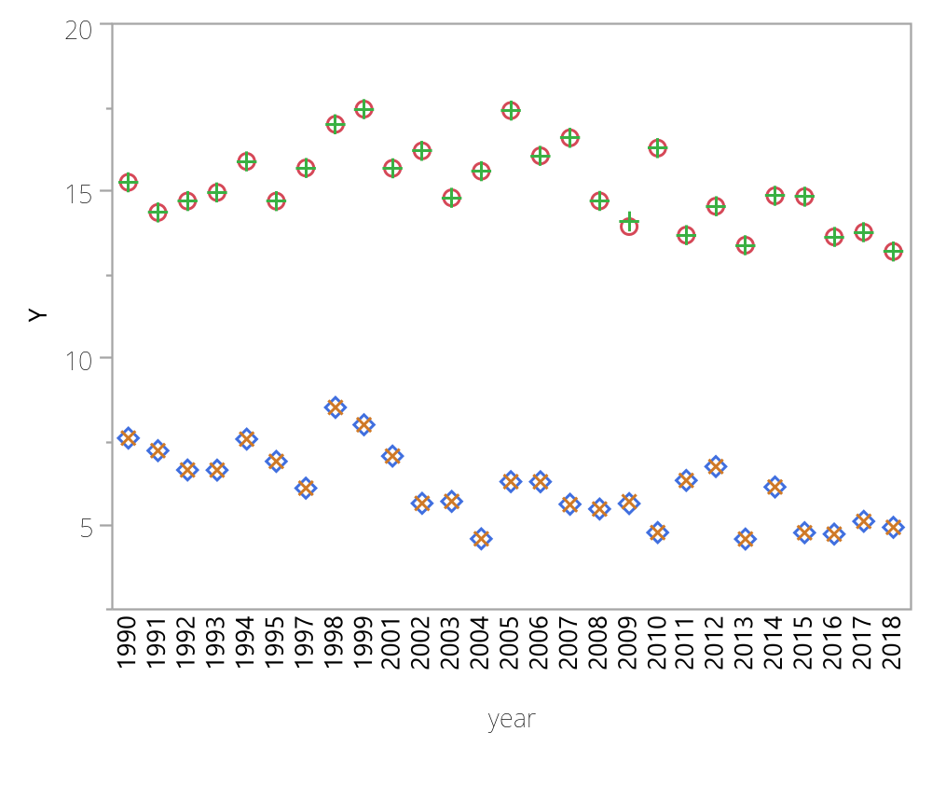
Chart site=BIBE1

Slide 11
Chart site=BIBE1

Slide 12
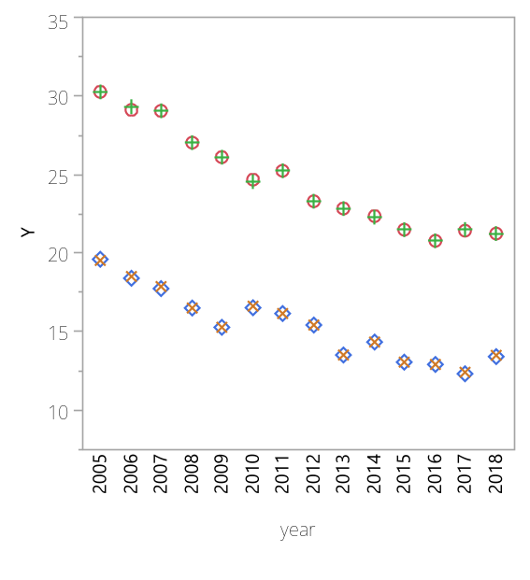
Chart site=BIRM1

Slide 13
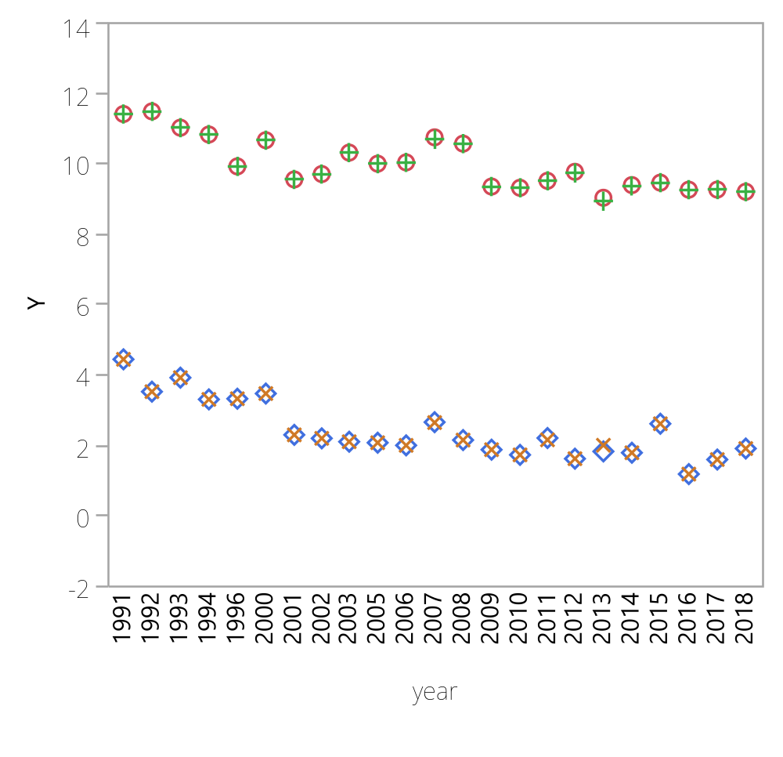
Chart site=BLIS1

Slide 14
Chart site=BLIS1

Slide 15
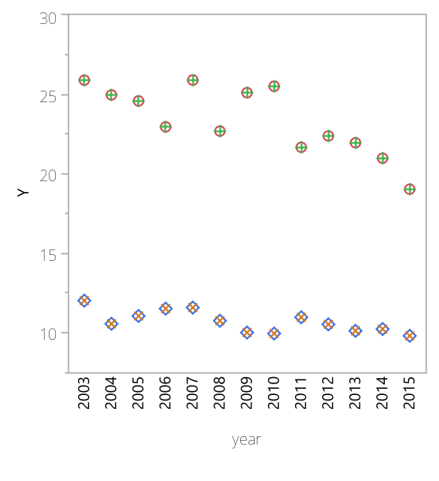
Chart site=BLMO1

Slide 16
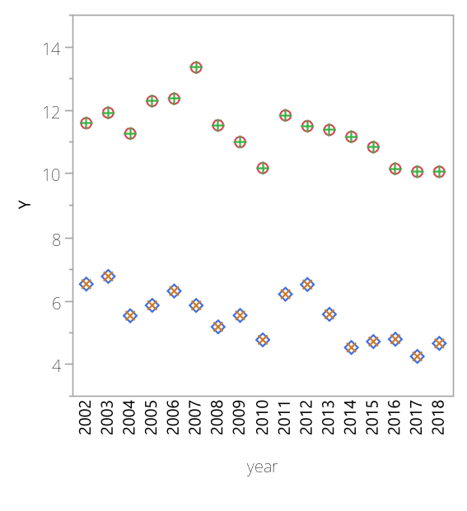
Chart site=BOAP1

Slide 17
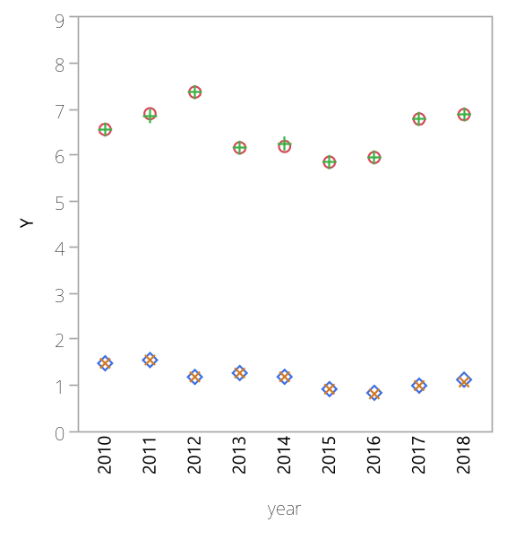
Chart site=BOLA1

Slide 18
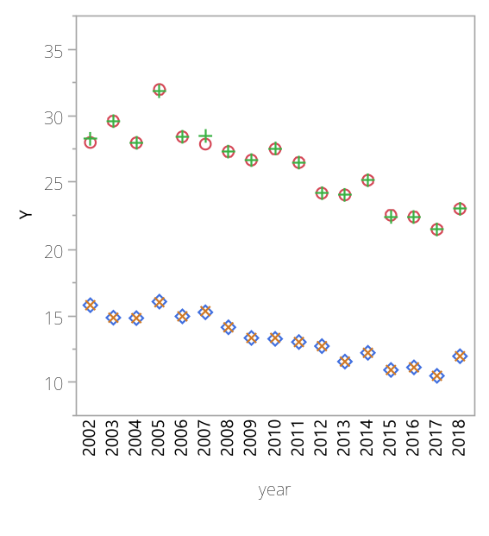
Chart site=BOND1

Slide 19
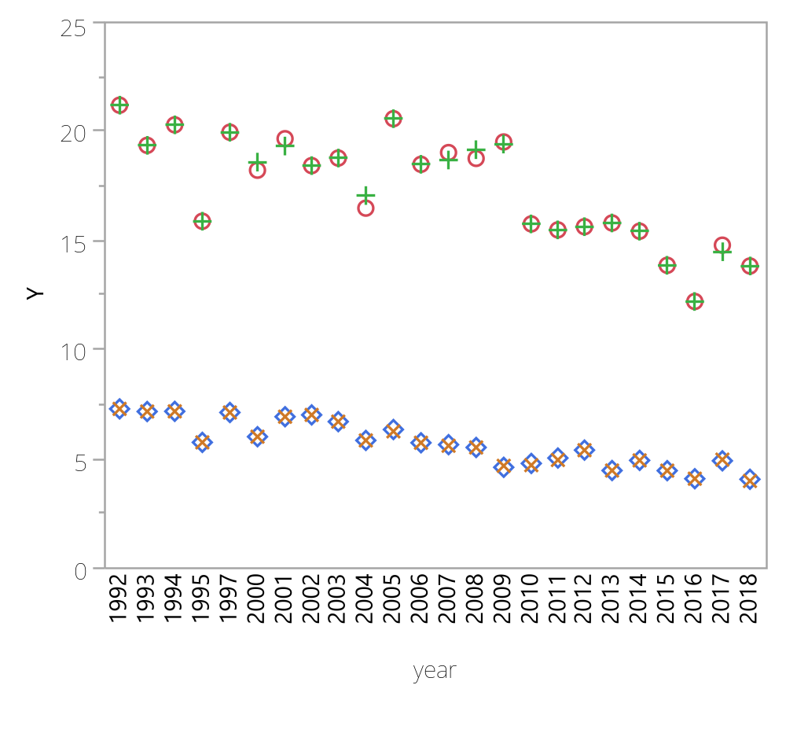
Chart site=BOWA1

Slide 20
Chart site=BOWA1

Slide 21
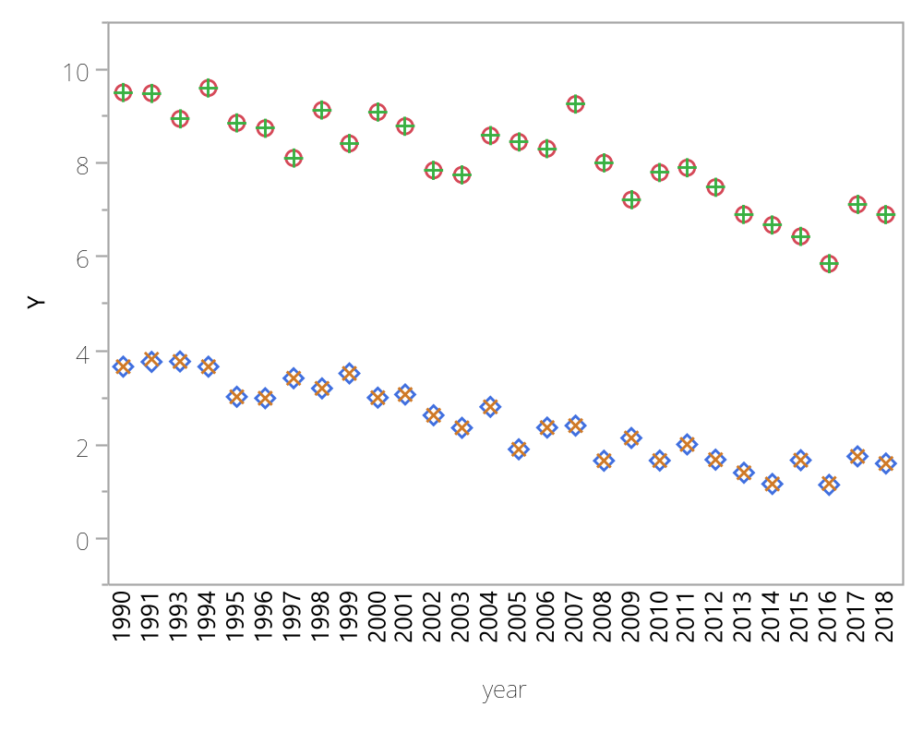
Chart site=BRCA1

Slide 22
Chart site=BRCA1

Slide 23
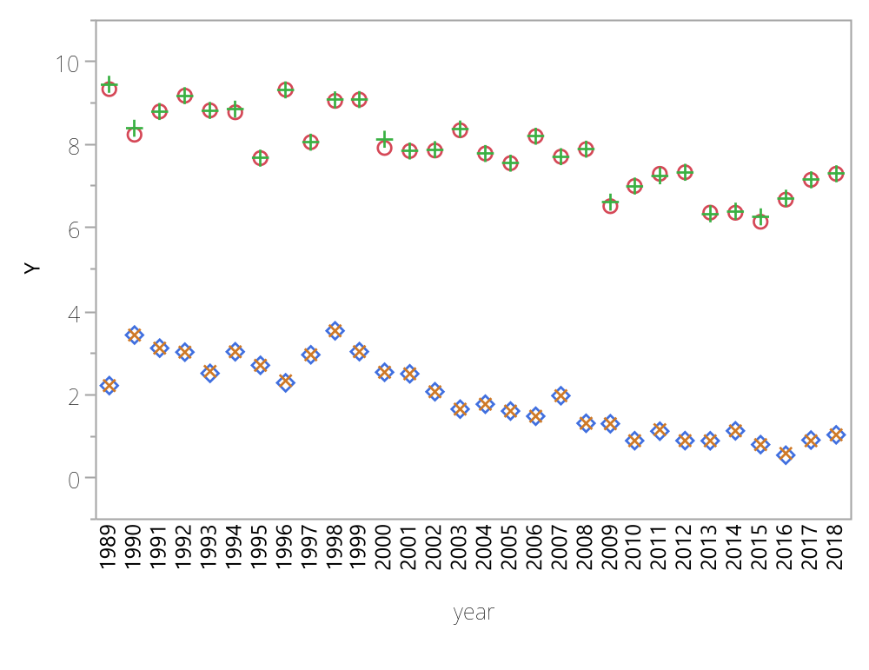
Chart site=BRID1

Slide 24
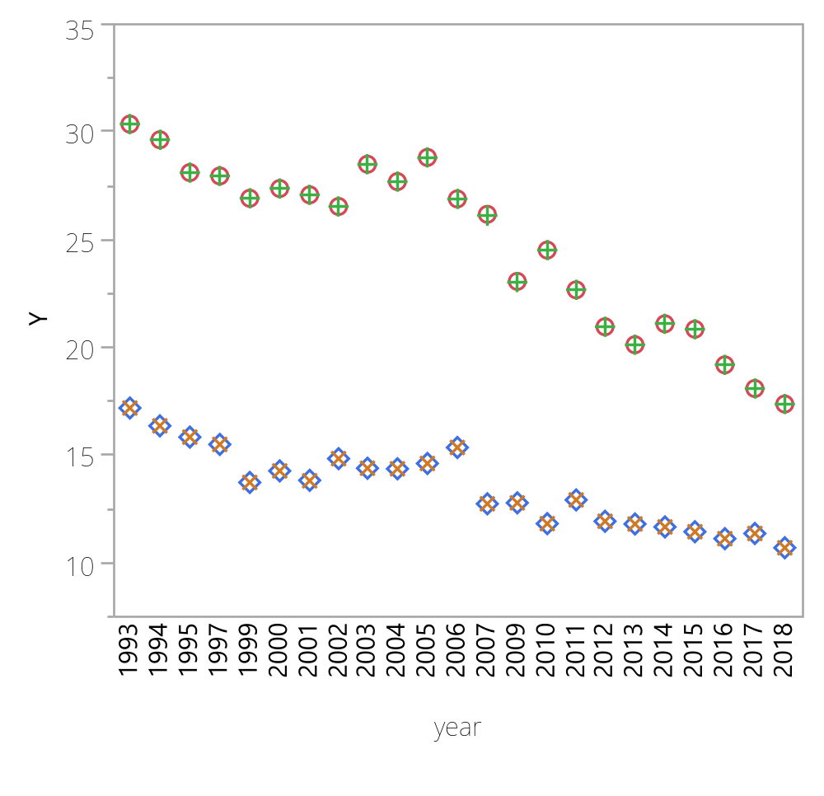
Chart site=BRIG1

Slide 25
Chart site=BRIG1

Slide 26
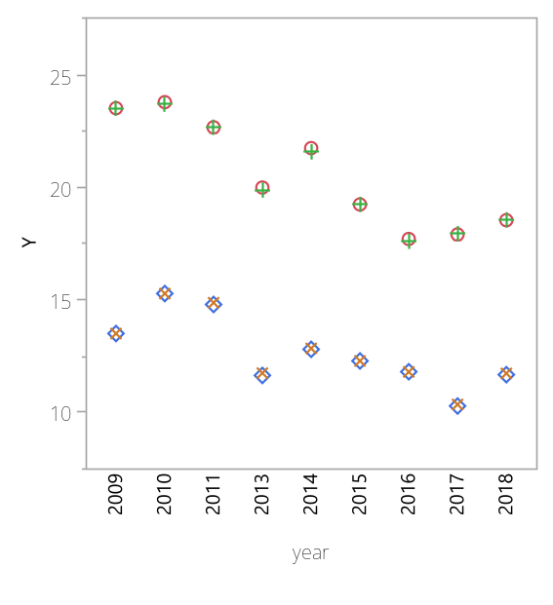
Chart site=BRIS1

Slide 27
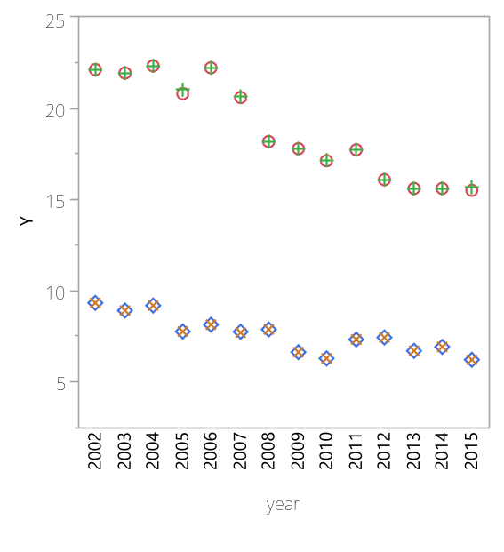
Chart site=BRMA1

Slide 28
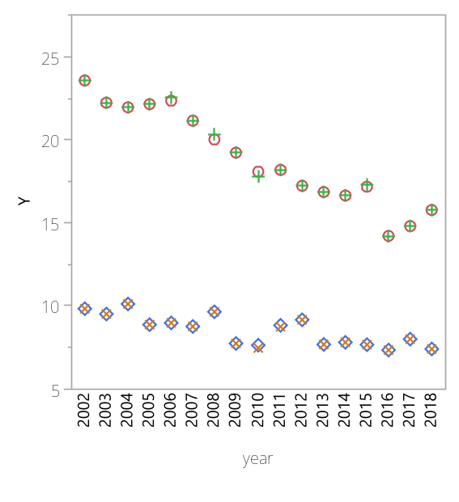
Chart site=CABA1

Slide 29
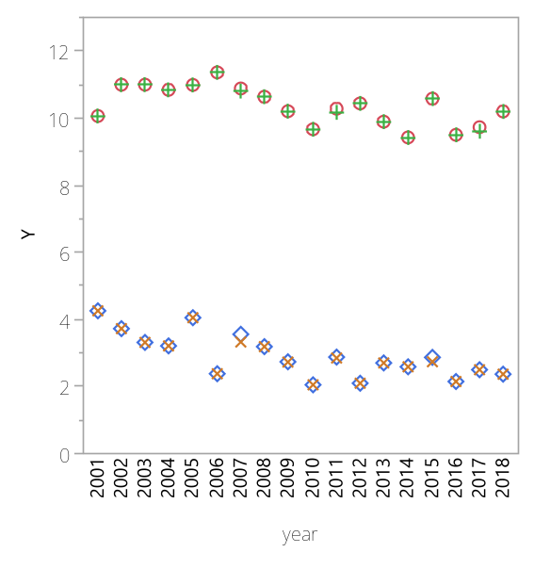
Chart site=CABI1

Slide 30
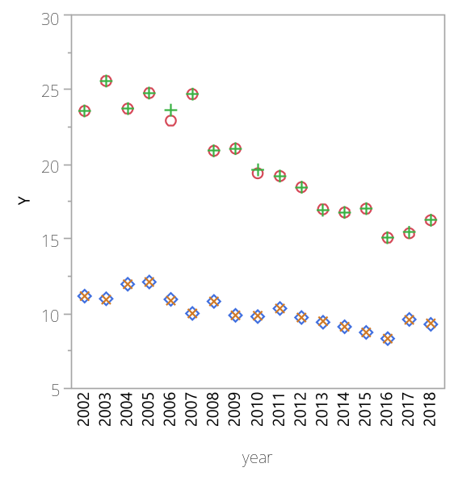
Chart site=CACO1

Slide 31
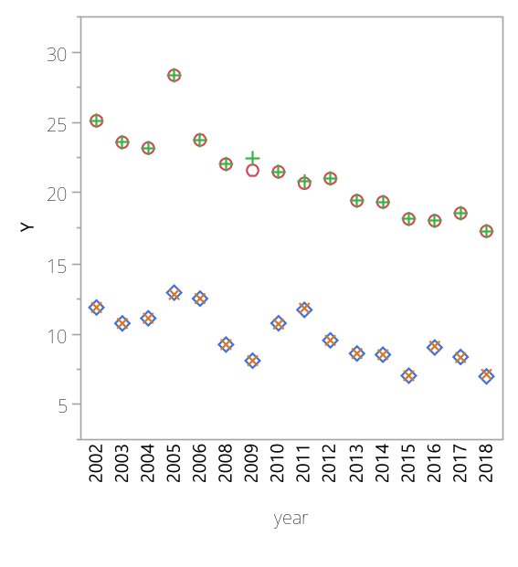
Chart site=CACR1

Slide 32
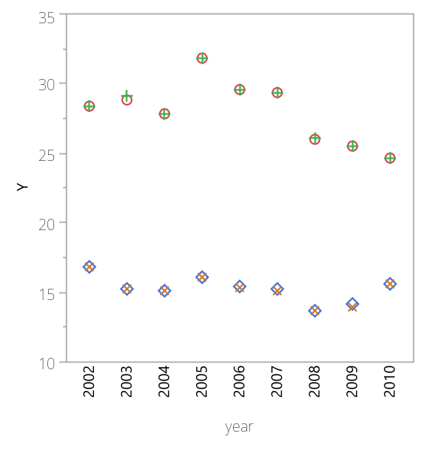
Chart site=CADI1

Slide 33
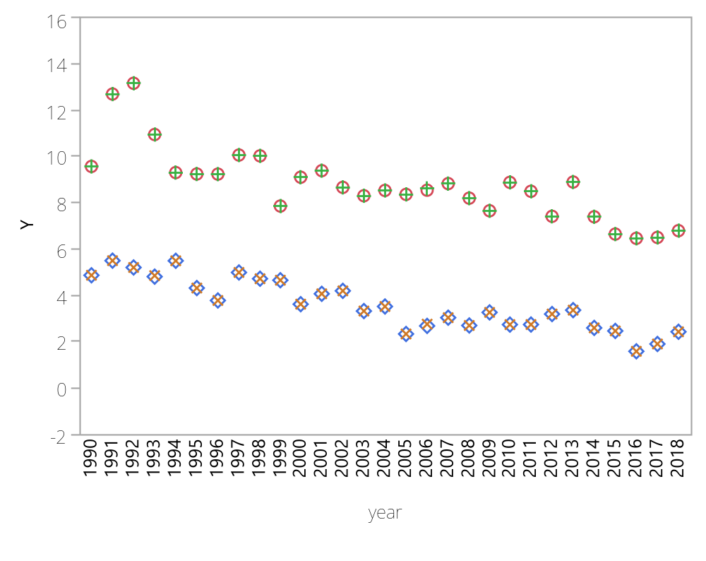
Chart site=CANY1

Slide 34
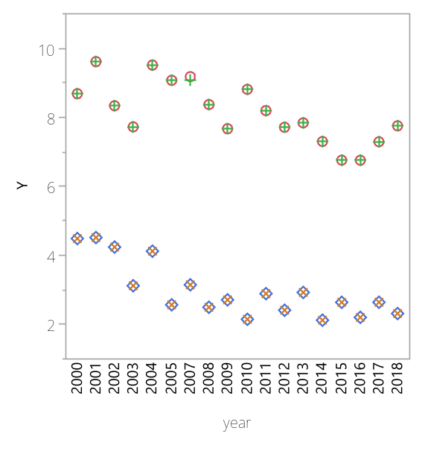
Chart site=CAPI1

Slide 35
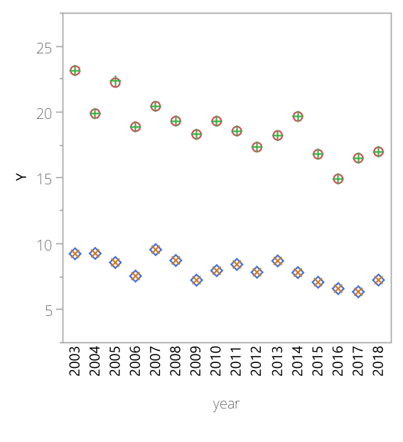
Chart site=CEBL1

Slide 36
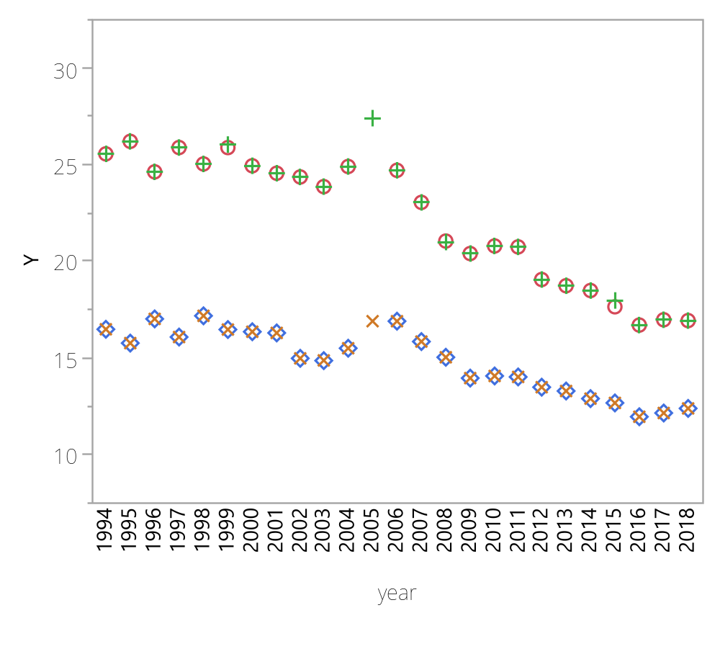
Chart site=CHAS1

Slide 37
Chart site=CHAS1

Slide 38
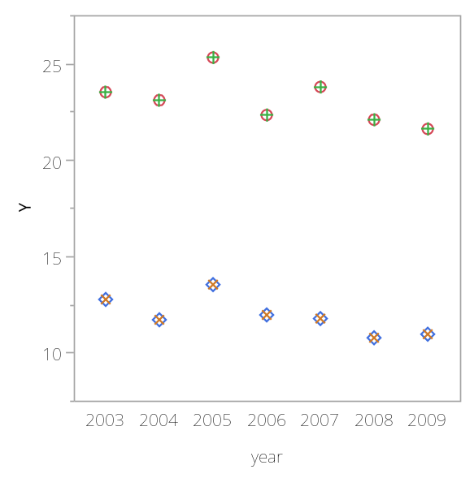
Chart site=CHER1

Slide 39
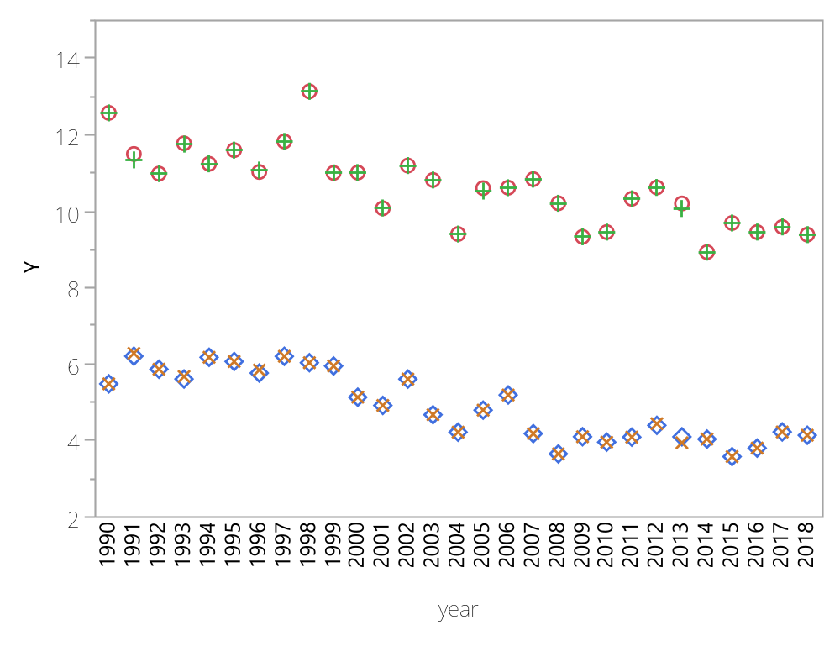
Chart site=CHIR1

Slide 40
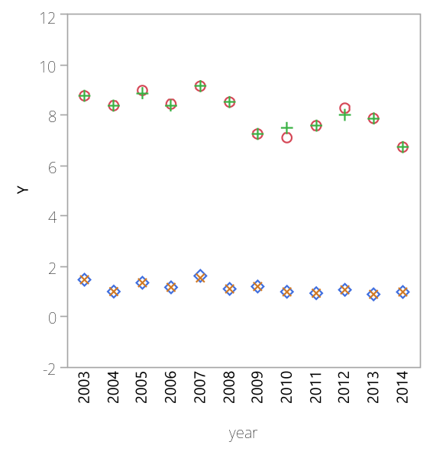
Chart site=CLPE1

Slide 41
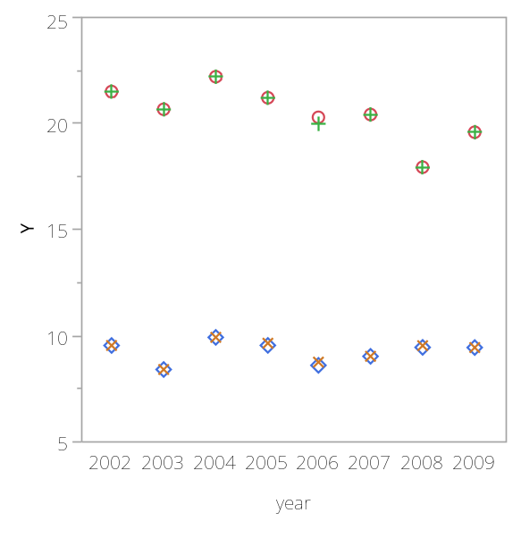
Chart site=COGO1

Slide 42
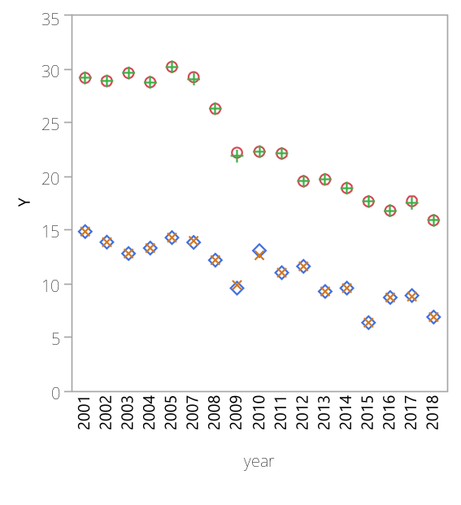
Chart site=COHU1

Slide 43
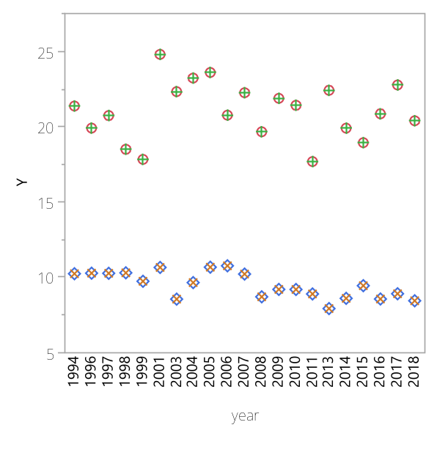
Chart site=CORI1

Slide 44
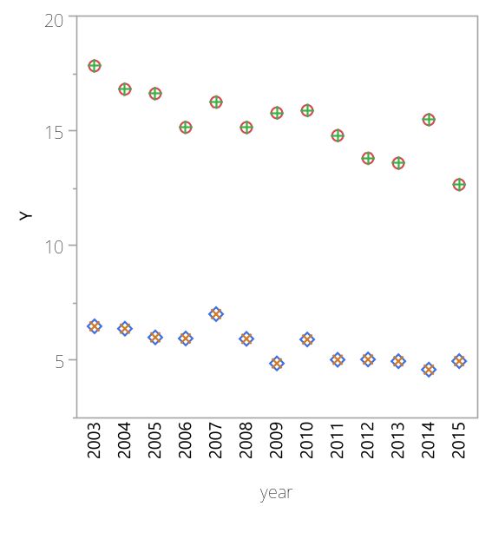
Chart site=CRES1

Slide 45
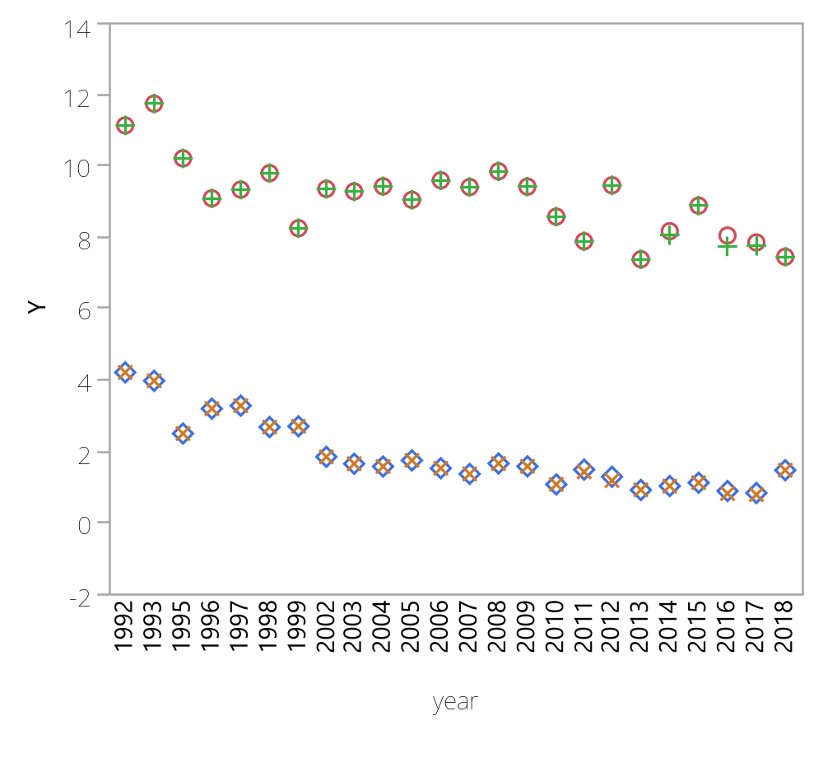
Chart site=CRLA1

Slide 46
Chart site=CRLA1

Slide 47
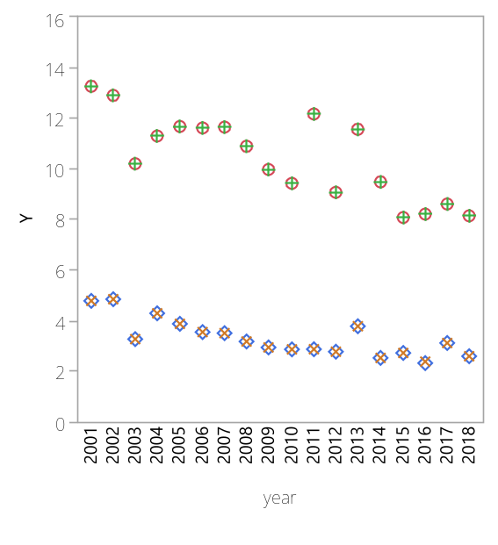
Chart site=CRMO1

Slide 48
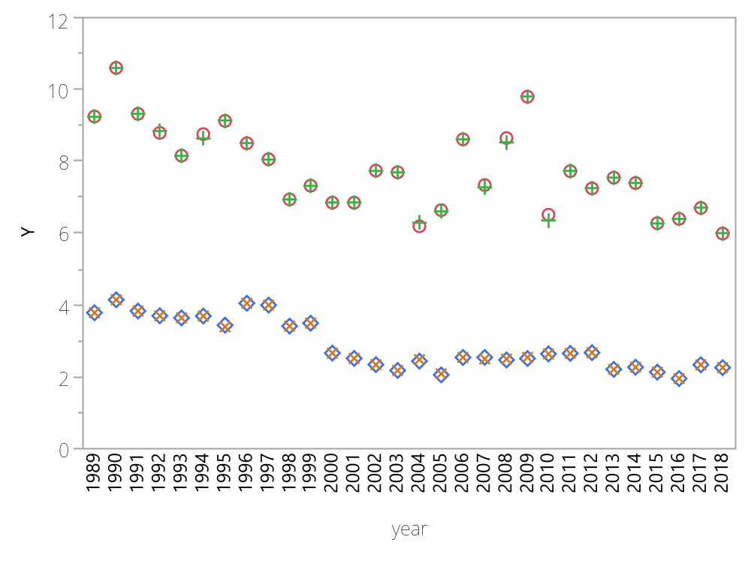
Chart site=DENA1

Slide 49
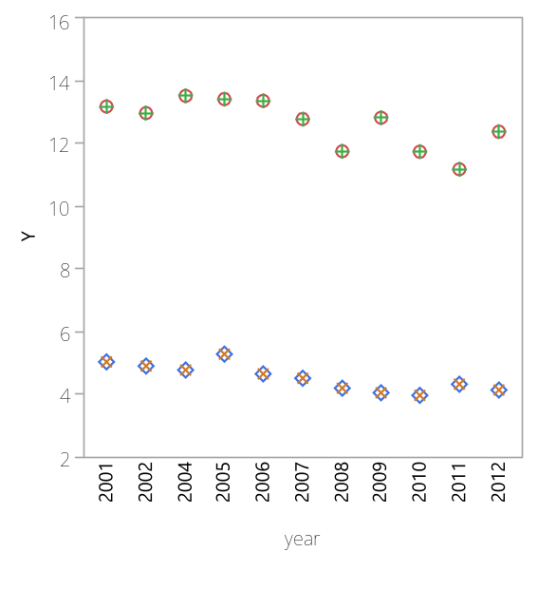
Chart site=DEVA1

Slide 50
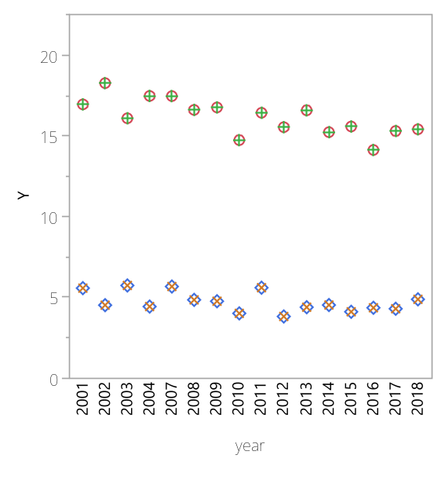
Chart site=DOME1

Slide 51
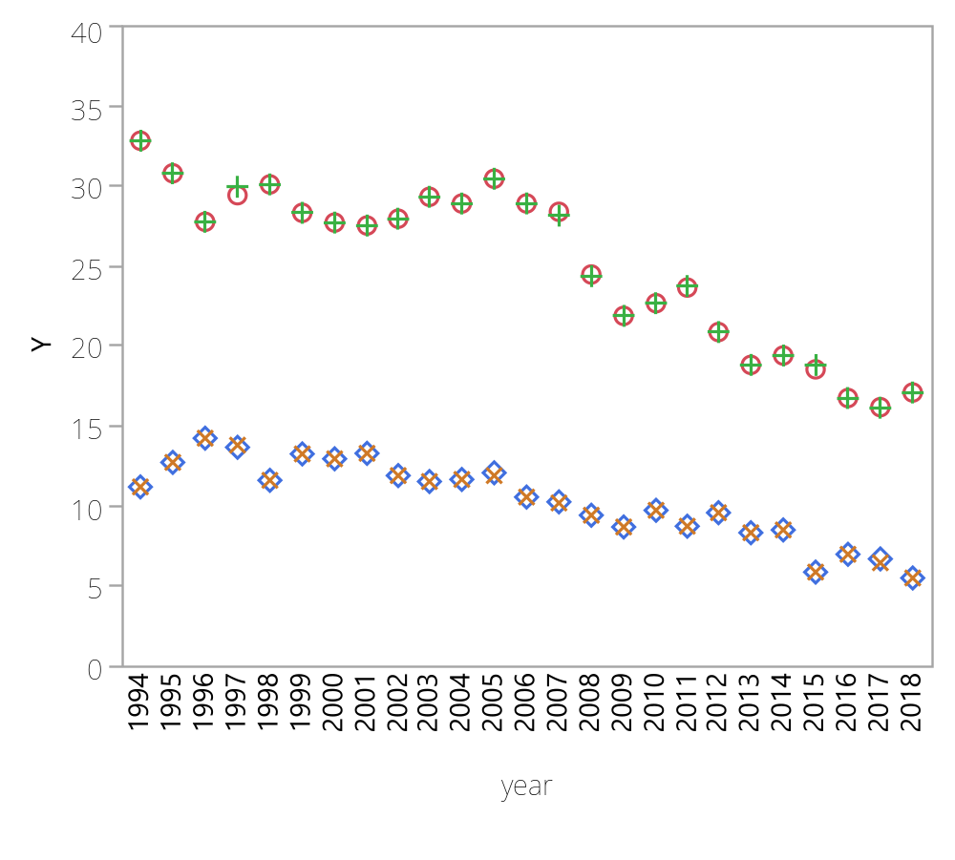
Chart site=DOSO1

Slide 52
Chart site=DOSO1

Slide 53
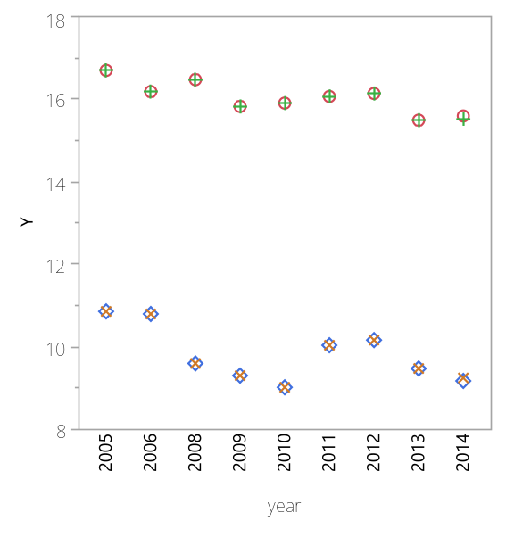
Chart site=DOUG1

Slide 54
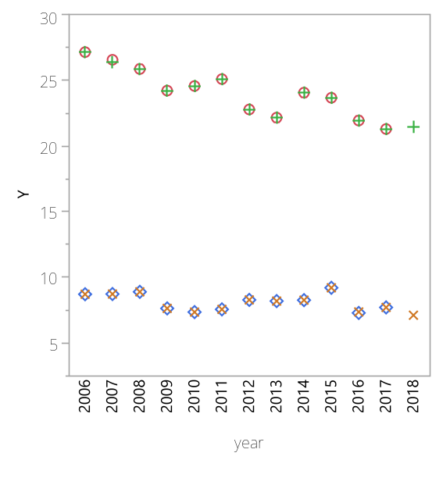
Chart site=EGBE1

Slide 55
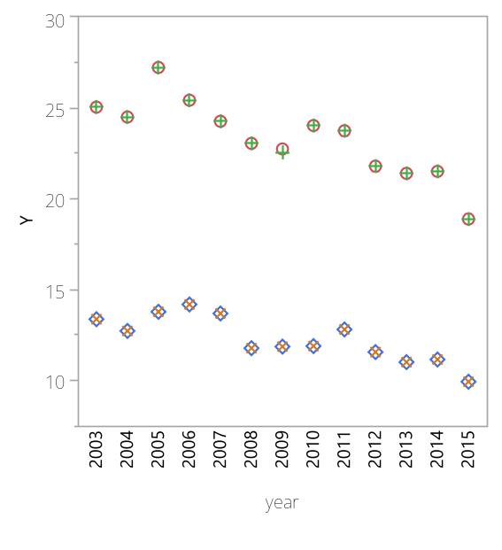
Chart site=ELDO1

Slide 56
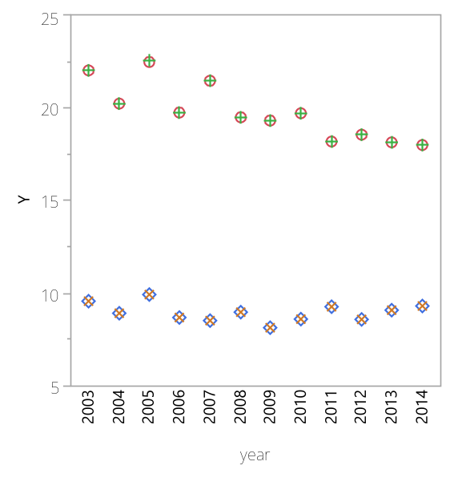
Chart site=ELLI1

Slide 57

Chart site=EVER1

Slide 58

Chart site=FLAT1

Slide 59

Chart site=FLTO1

Slide 60

Chart site=FOPE1

Slide 61

Chart site=FRES1

Slide 62

Chart site=FRRE1

Slide 63

Chart site=GAMO1

Slide 64

Chart site=GICL1

Slide 65
Chart site=GICL1

Slide 66

Chart site=GLAC1

Slide 67

Chart site=GRBA1

Slide 68
Chart site=GRBA1

Slide 69

Chart site=GRCA2

Slide 70
Chart site=GRCA2

Slide 71

Chart site=GRGU1

Slide 72

Chart site=GRRI1

Slide 73

Chart site=GRSA1

Slide 74

Chart site=GRSM1

Slide 75

Chart site=GUMO1

Slide 76

Chart site=HACR1

Slide 77

Chart site=HALE1

Slide 78

Chart site=HAVO1

Slide 79

Chart site=HECA1

Slide 80

Chart site=HEGL1

Slide 81

Chart site=HOOV1

Slide 82

Chart site=IKBA1

Slide 83

Chart site=INGA1

Slide 84

Chart site=ISLE1

Slide 85

Chart site=JARB1

Slide 86
Chart site=JARB1

Slide 87
Chart site=JARI1

Slide 88
Chart site=JOSH1

Slide 89
Chart site=KAIS1

Slide 90
Chart site=KALM1

Slide 91
Chart site=LABE1

Slide 92
Chart site=LASU2

Slide 93
Chart site=LAVO1

Slide 94
Chart site=LIGO1

Slide 95

Chart site=LIVO1

Slide 96

Chart site=LOND1

Slide 97

Chart site=LOST1

Slide 98

Chart site=LYBR_RHTS

Slide 99
Chart site=LYBR_RHTS

Slide 100

Chart site=LYBR1

Slide 101

Chart site=MACA1

Slide 102
Chart site=MACA1

Slide 103

Chart site=MAKA2

Slide 104

Chart site=MAVI1

Slide 105

Chart site=MEAD1

Slide 106
Chart site=MELA1

Slide 107
Chart site=MEVE1

Slide 108
Chart site=MEVE1

Slide 109
Chart site=MING1

Slide 110
Chart site=MKGO1

Slide 111
Chart site=MOHO1

Slide 112
Chart site=MOMO1

Slide 113
Chart site=MONT1

Slide 114
Chart site=MOOS1

Slide 115
Chart site=MOOS1

Slide 116
Chart site=MORA1

Slide 117
Chart site=MORA1

Slide 118
Chart site=MOZI1

Slide 119
Chart site=MOZI1

Slide 120
Chart site=NEBR1

Slide 121
Chart site=NEYO1

Slide 122
Chart site=NOAB1

Slide 123
Chart site=NOCA1

Slide 124
Chart site=NOCH1

Slide 125
Chart site=OKEF1

Slide 126
Chart site=OKEF1

Slide 127

Chart site=OLYM1

Slide 128

Chart site=ORPI1

Slide 129

Chart site=OWVL1

Slide 130

Chart site=PACK1

Slide 131

Chart site=PASA1

Slide 132

Chart site=PEFO1

Slide 133
Chart site=PEFO1

Slide 134

Chart site=PENO1

Slide 135

Chart site=PHOE1

Slide 136

Chart site=PINN1

Slide 137
Chart site=PINN1

Slide 138

Chart site=PMRF1

Slide 139

Chart site=PORE1

Slide 140
Chart site=PORE1

Slide 141

Chart site=PRIS1

Slide 142

Chart site=PUSO1

Slide 143

Chart site=QUCI1

Slide 144

Chart site=QURE1

Slide 145

Chart site=QUVA1

Slide 146

Chart site=RAFA1

Slide 147

Chart site=REDW1

Slide 148

Chart site=ROMA1

Slide 149

Chart site=ROMO1

Slide 150
Chart site=ROMO1

Slide 151

Chart site=SACR1

Slide 152

Chart site=SAFO1

Slide 153

Chart site=SAGA1

Slide 154

Chart site=SAGO1

Slide 155
Chart site=SAGO1

Slide 156

Chart site=SAGU1

Slide 157

Chart site=SAMA1

Slide 158

Chart site=SAPE1

Slide 159

Chart site=SAWE1

Slide 160

Chart site=SAWT1

Slide 161

Chart site=SENE1

Slide 162

Chart site=SEQU1

Slide 163
Chart site=SEQU1

Slide 164

Chart site=SHEN1

Slide 165
Chart site=SHEN1

Slide 166

Chart site=SHMI1

Slide 167

Chart site=SHRO1

Slide 168

Chart site=SIAN1

Slide 169

Chart site=SIKE1

Slide 170

Chart site=SIME1

Slide 171

Chart site=SIPS1

Slide 172

Chart site=SNPA1

Slide 173

Chart site=STAR1

Slide 174

Chart site=STIL1

Slide 175

Chart site=SULA1

Slide 176

Chart site=SWAN1

Slide 177

Chart site=SYCA_RHTS

Slide 178

Chart site=SYCA1

Slide 179

Chart site=TALL1

Slide 180

Chart site=THBA1

Slide 181

Chart site=THRO1

Slide 182

Chart site=THSI1

Slide 183
Chart site=THSI1

Slide 184

Chart site=TONT1

Slide 185
Chart site=TONT1

Slide 186

Chart site=TRCR1

Slide 187

Chart site=TRIN1

Slide 188

Chart site=TUXE1

Slide 189

Chart site=ULBE1

Slide 190

Chart site=UPBU1

Slide 191
Chart site=UPBU1

Slide 192

Chart site=VIIS1

Slide 193

Chart site=VILA1

Slide 194

Chart site=VOYA2

Slide 195

Chart site=WASH1

Slide 196

Chart site=WEMI1

Slide 197

Chart site=WHIT1

Slide 198

Chart site=WHPA1

Slide 199

Chart site=WHPE1

Slide 200

Chart site=WHRI1

Slide 201

Chart site=WICA1

Slide 202

Chart site=WIMO1

Slide 203

Chart site=YELL2

Slide 204
Chart site=YELL2

Slide 205

Chart site=YOSE1

Slide 206

Chart site=ZICA1

