Slide 1
Changes to IMPROVE RHR Calculations and Metrics since 10/2019 version before changing patching routine
Results are graphically displayed in
“Compare 10_2019 with 12_2019_1p.pptx”
Available here
https://drive.google.com/open?id=0Bxfj1vyyXeDYWVpfeUo4NEYtTU0
Scott Copeland 12_19_2019

Slide 2
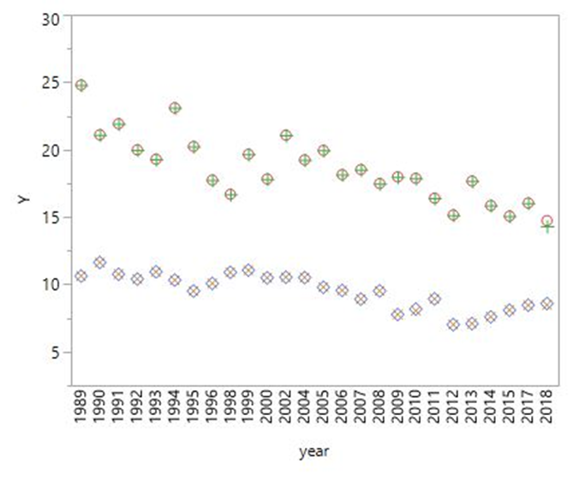

UCD limited data redelivery
Several sample dates with erroneously missing XRF values at 8 sites for parts of 2018 were restored.
Missing IC data for three days at AGTI1 in 2018 were restored – all three days remain invalid for RHR metrics.
LOST1 Lostwood NWR, ND - 08/26/2017-12/31/2018, A module only.
WICA1 Wind Cave NP, SD - 07/1/2018-12/31/2018, B module only.
  -> Status flags were set to “SA”. Data from LOST and WICA are still used provisionally for RHR metric calculation.
Cumulative effects of all three issues:
 | Reported Data | Clearest Days | Most Impaired Days | 2000-2004 Baseline | Natural Conditions Estimates | 2064 endpoints
Significance of change | minor | very minor | Moderate at PORE1, minor everywhere else | n/a | n/a | n/a
Number of sites affected | AGTI1, BLIS1, BRCA1, MORA1, PORE1, REDW1, SEQU1, WHPA1, YOSE1 | 9 | 9 | - | - | -
Chart site=PORE1

Slide 3
Modification of legacy status flags at four sites
“SA”* codes were changed to “TU”* codes for all four modules at 4 sites in 2002 or 2006 after a review of my notes indicated that the “SA” code had been assigned before the “TU” code was in use. “TU” is used to indicate timers that are set up to 24 hours off of the correct time. These reflagged observations are now used for RHR metrics.
At AGTI1, SULA1 and KAIS1, adding these days allowed 2006 to meet the completeness requirements, which they previously did not. BALD1 2002 had already been completed through data substitution.
 | Reported Data | Clearest Days | Most Impaired Days | 2000-2004 Baseline | Natural Conditions Estimates | 2064 endpoints
Significance of change | high | high | high | minor | minor | minor
Number of sites affected | AGTI1, SULA1, KAIS1, 2006 and BALD1 2002 | AGTI1, SULA1, KAIS1, 2006 and BALD1 2002 | AGTI1, SULA1, KAIS1, 2006 and BALD1 2002 | BALD1 | BALD1 | AGTI1, SULA1, KAIS1, and BALD1
*“SA” means “Sampling Anomaly” and is used to describe a wide range of issues including obvious impacts from unusual sources or sampler issues. Data is normally delivered to FED but not used for RHR calculations.
*“TU” is used to indicate controller clocks not set to the correct time. Since the “TU” flag was created, these observations have been considered valid for RHR metrics. Care should be taken to remove them from analyses that depend directly on the timing of the sample, e.g. comparisons with other monitors.

Slide 4
Typo
Corrected a long standing typo in the RHR data patching algorithm. The effect was a small random error in determining whether sea_salt patching was allowed. Only sea_salt patching was affected. Only applicable to a small fraction of observations where sea salt wasn’t already valid.
 | Reported Data | Clearest Days | Most Impaired Days | 2000-2004 Baseline | Natural Conditions Estimates | 2064 endpoints
Significance of change | n/a | very minor | very minor | very minor | very minor | very minor
Number of sites affected | - | potentially all | potentially all | potentially all | potentially all | potentially all

Slide 5
Addition of new combined haze tracking site
RHR metrics now include a “SYCA_RHTS” site code which is the combined trending site that treats SYCA1 and SYCA2(which began 24OCT2015) as a single site with no data modification.
This was based on an analysis that I performed and shared with AZDEQ of the two sites’ data compared with nearby sites.
2015 is now a “complete” year for the hybrid site.
 | Reported Data | Clearest Days | Most Impaired Days | 2000-2004 Baseline | Natural Conditions Estimates | 2064 endpoints
Significance of change | n/a | High | high | n/a | n/a | n/a
Number of sites affected | - | SYCA_RHTS 2015 only | SYCA_RHTS 2015 only | - | - | -

Slide 6
Addition of EPA 2019 results to my default 2064 endpoint file
I am now including the output of the 2019 EPA modeling effort in my 2064 endpoint file for every class I IMPROVE site.
This is for convenience in evaluating the numbers for myself and the community.
I haven’t evaluated the numbers and how they interact with the glide slopes yet.
The most recent version of that file is “endpoint_2064_imp_g_90_12_19_2p.csv”

Slide 7
Changes to IMPROVE RHR Calculations and Metrics after changing only “patching” routine
Results are graphically displayed in
“Compare 12_2019_1p with 12_2019_2p.pptx”
Available here
https://drive.google.com/open?id=0Bxfj1vyyXeDYWVpfeUo4NEYtTU0
Scott Copeland 12_19_2019

Slide 8
Extended Patching
RHR Guidance based “patching” algorithm was extended to allow up to two missing components of aerosol extinction at one site on one date to be replaced per the guidance technique, rather than just one.
The test is performed for each missing component independently, not combinations of missing components as was described in the 2003 guidance.
This change is a response to a request by LADCO analysts in 2017 to allow a subset of important sample dates to be used in progress determinations and is a reasonable extension of the guidance technique.
This change is the minimum modification to the patching algorithm that can still recover most of the important sample dates at the LADCO sites.
About 2200 additional sample dates are recovered at various sites since 2000.
At the IMPROVE Steering Committee meeting in Petaluma and at the National Regional Haze meeting in St Louis, I recommended allowing three components per day to be replaced, but changed to two after a careful inspection of the results, especially at high elevation western sites.
Every patched or substituted value is now reported explicitly with each data version for each affected site and date. See All_patches_12_19_2p.csv and subs_rhr_5_2019.csv on Google Drive.
 | Reported Data | Clearest Days | Most Impaired Days | 2000-2004 Baseline | Natural Conditions Estimates | 2064 endpoints
Significance of change | n/a | mostly minor-some moderate-one high | mostly minor-some moderate-one high | minor | minor | minor
Number of sites affected | - | potentially all | potentially all | next slide | next slide | potentially all

Slide 9
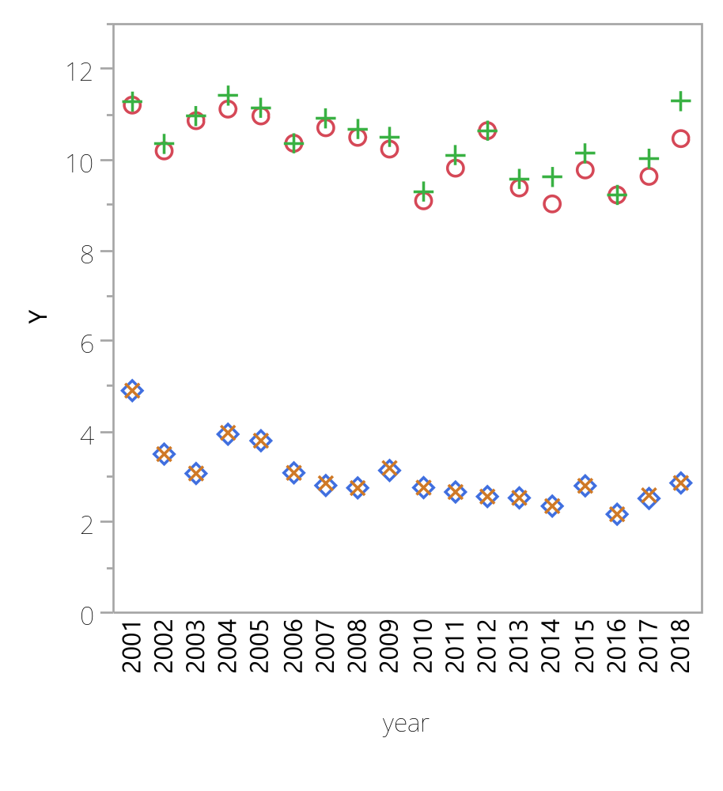
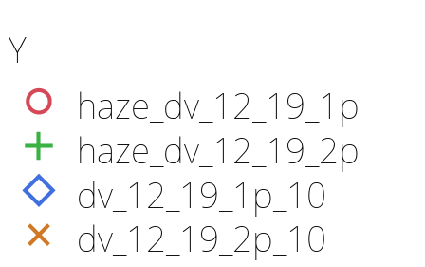
More about the baseline period
Below left are all the class I area sites that had at least one observation changed in the baseline period. All of them could have changes to baseline values, natural_conditions2 values, endpoint values, and impairment metrics.
  In most cases the changes are very small.
The largest changes by a wide margin were at MONT1 (Bob Marshall, and Mission Mountains Wilderness) in Montana.
  The large change at MONT1 results from a few added high fire days that changed the min95 carbon threshold, which then changed the impairment values in most years.
Chart site=MONT1
ACAD1 AGTI1 BAND1 BOWA1 BRCA1 BRET1 BRIG1 CHAS1 CHIR1 CRLA1 DENA1 EVER1 GICL1 GRCA2 GRGU1 GRSM1 GUMO1 HALE1 HAVO1 HEGL1 HOOV1 ISLE1 KAIS1 KALM1 LAVO1 MELA1 MEVE1 MONT1 MOOS1 OKEF1 PASA1 PMRF1 PORE1 REDW1 SAMA1 SAWT1 SENE1 SHEN1 SHRO1 SIPS1 SNPA1 SULA1 SWAN1 THSI1 TRCR1 TRIN1 TUXE1 UPBU1 VOYA2 WHPA1 WHPE1 YELL2 YOSE1

Slide 10
Historical changes after this slide

Slide 11
Changes to IMPROVE RHR Calculations and Metrics between 5/2019 and 10/2019 versions

Slide 12
Modified chloride calculation
Chloride algorithm updated prior to 10_19 version to reflect dramatically reduced IC chloride artifact after 2003.
 | Reported Data | Clearest Days | Haziest Days | Most Impaired Days | Natural Conditions Estimates | 2064 endpoints
Significance of change | very minor | very minor | very minor | very minor | very minor | very minor
Number of sites affected | all | all | all | all | all | all
The old way
Chloride=chlf/1000;
Chlorine=clf/1000;
Sea_Salt=1.8*Chloride;
if ((year le 2003) and (chlf < chlf_mdl or chlf=.)) then Sea_Salt=1.8*Chlorine;
if ((year gt 2003) and (chlf < chlf_mdl or chlf=.) and (clf ne .)) then Sea_Salt=1.8*Chlorine;
A “.” represents a missing observation
The new way

